Slide 1
Multi-Period Optimal Power Flow for Active Power Distribution Systems
Aryan Ritwajeet Jha
Graduate Research Assistant
Washington State University
Notes:
Remember to hit the reset button to make sure all the page elements react properly.
There are 20 different layouts that you can choose from.

Slide 2
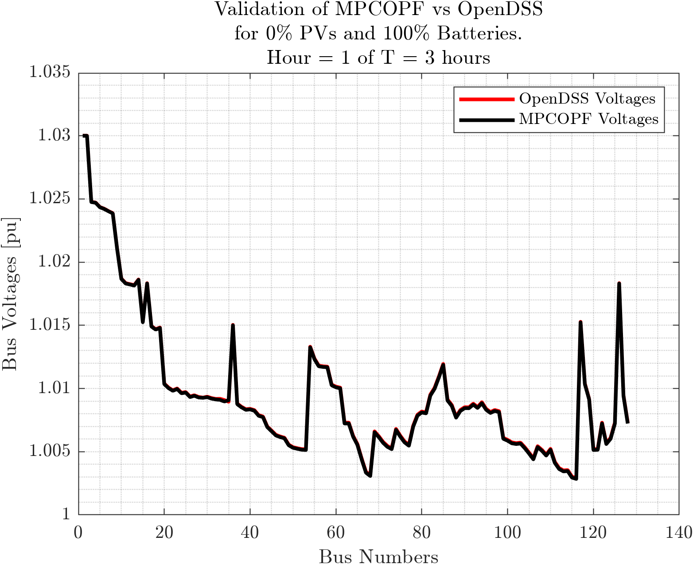

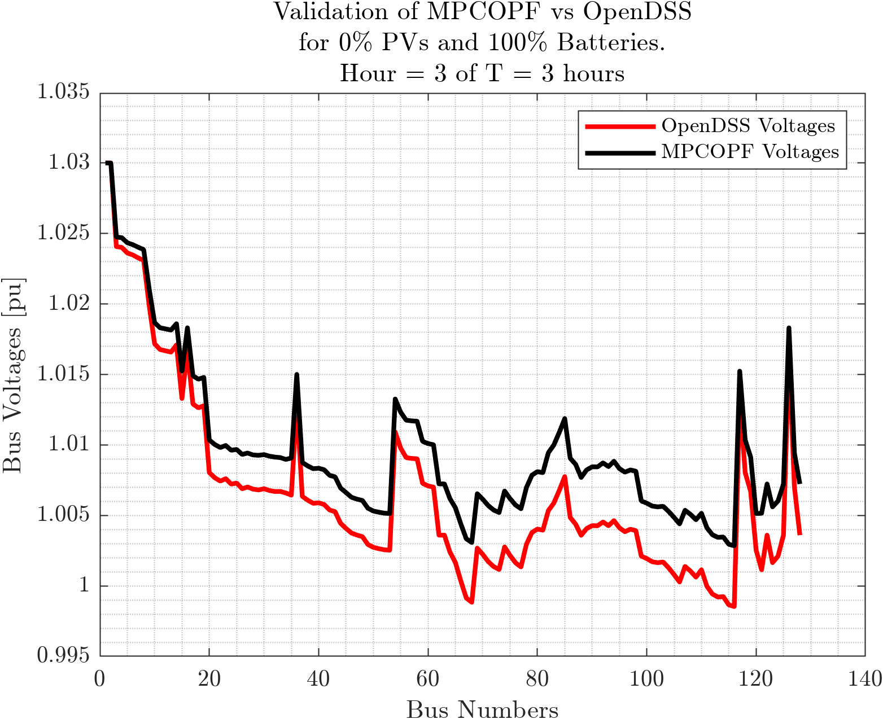
Current Issue: Some mismatch in MPCOPF results Seeming mismatch between specified (from OPF) and assigned values (into OpenDSS) for Battery Reactive Powers

Slide 3
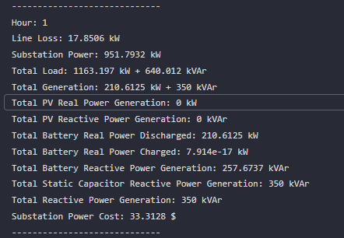
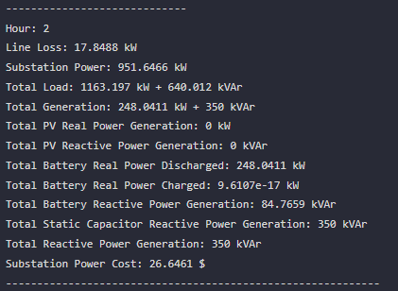
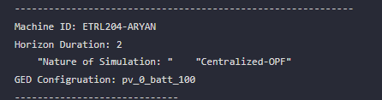
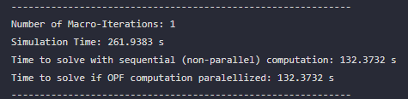
Currently Doing: Extracting Results on an Hourly (Time-step) Basis, for hourly comparison against OpenDSS

Slide 4
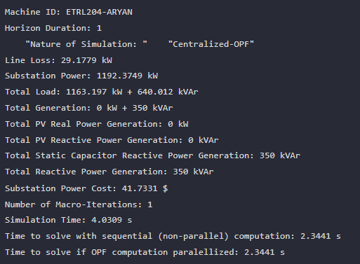
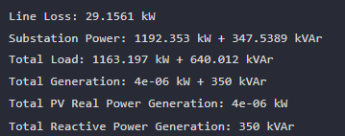
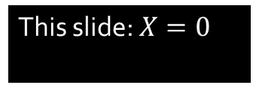
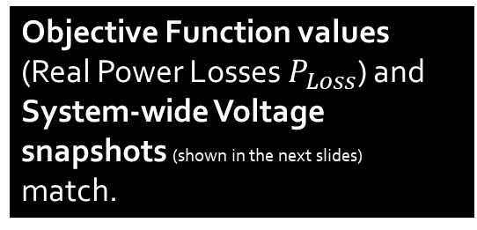
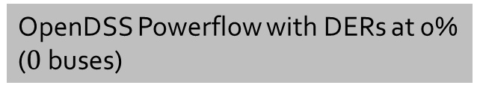
IEEE $123 X\%$PVs, $0\%$Batteries. COPF. $T = 1$
Objective Function values (Real Power Losses $P_{Loss}$) and System-wide Voltage snapshots (shown in the next slides) match.
This slide: $X=0$
Multi-Period Simulation, T = 1, Batteries at 0%, DERs at 0% ($0$ buses)
OpenDSS Powerflow with DERs at 0% ($0$ buses)

Slide 5
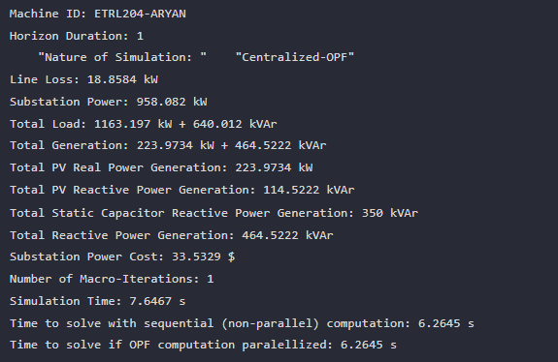
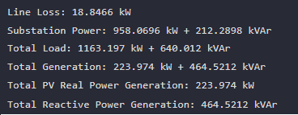
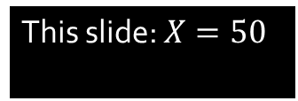

IEEE $123 X\%$PVs, $0\%$Batteries. COPF. $T = 1$
Objective Function values (Real Power Losses $P_{Loss}$) and System-wide Voltage snapshots (shown in the next slides) match.
This slide: $X=50$
Multi-Period Simulation, T = 1, Batteries at 0%, DERs at 50% ($43$ buses)
OpenDSS Powerflow with DERs at 50% ($43$ buses)

Slide 6
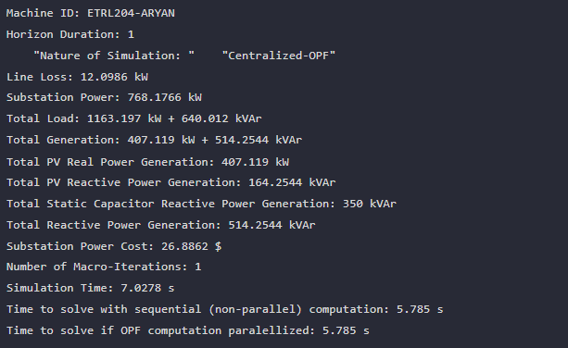
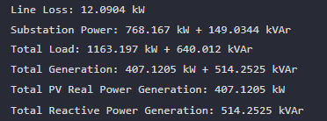
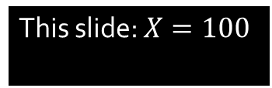

IEEE $123 X\%$PVs, $0\%$Batteries. COPF. $T = 1$
Objective Function values (Real Power Losses $P_{Loss}$) and System-wide Voltage snapshots (shown in the next slides) match.
This slide: $X=100$
Multi-Period Simulation, T = 1, Batteries at 0%, DERs at 100% ($85$ buses)
OpenDSS Powerflow with DERs at 100% ($85$ buses)

Slide 7
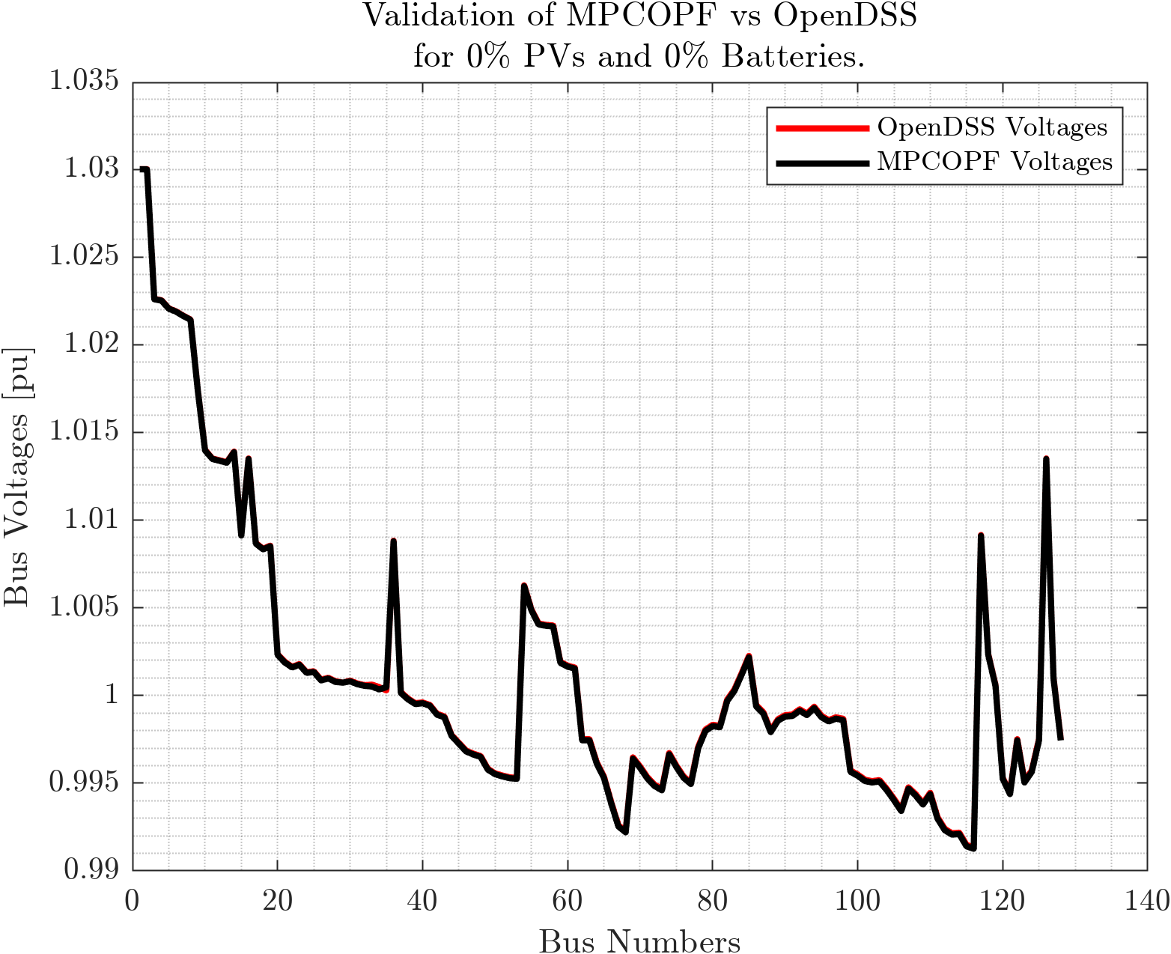
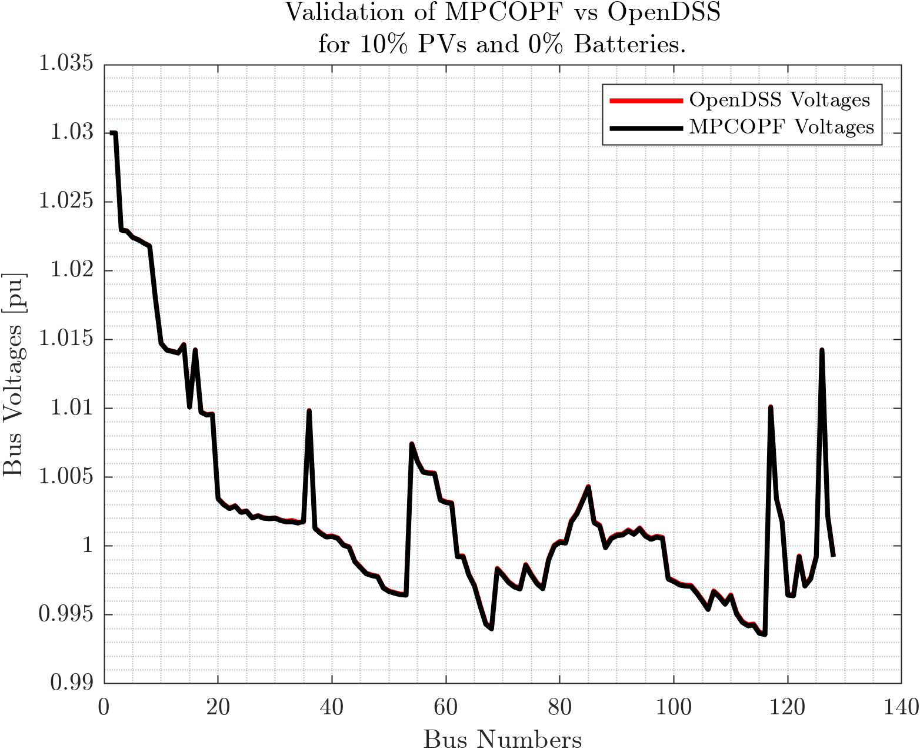
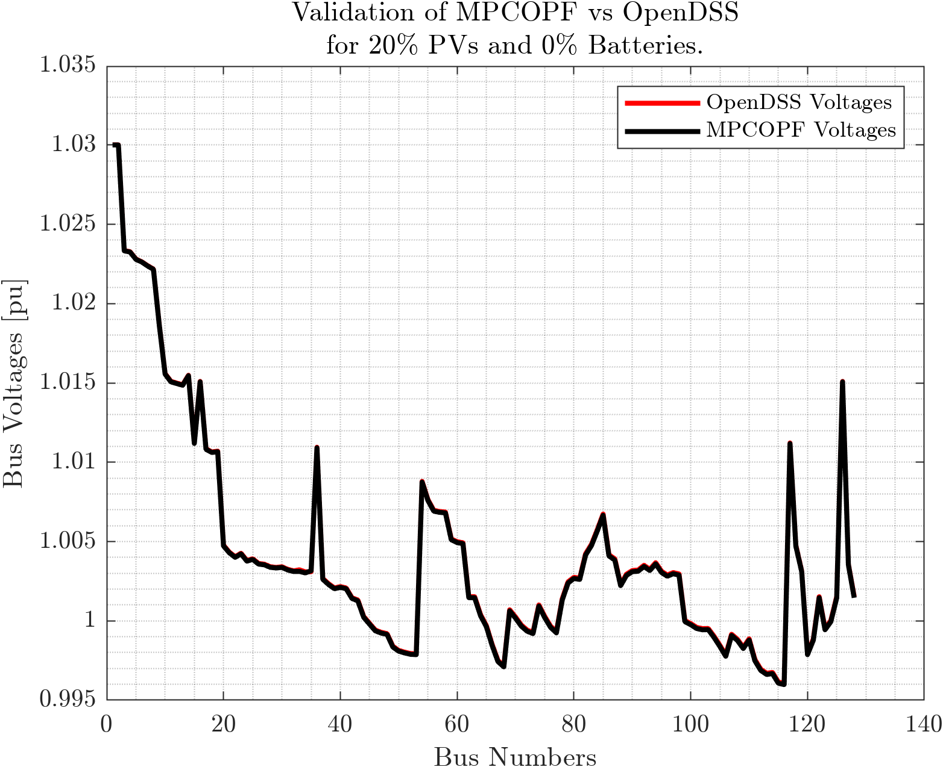
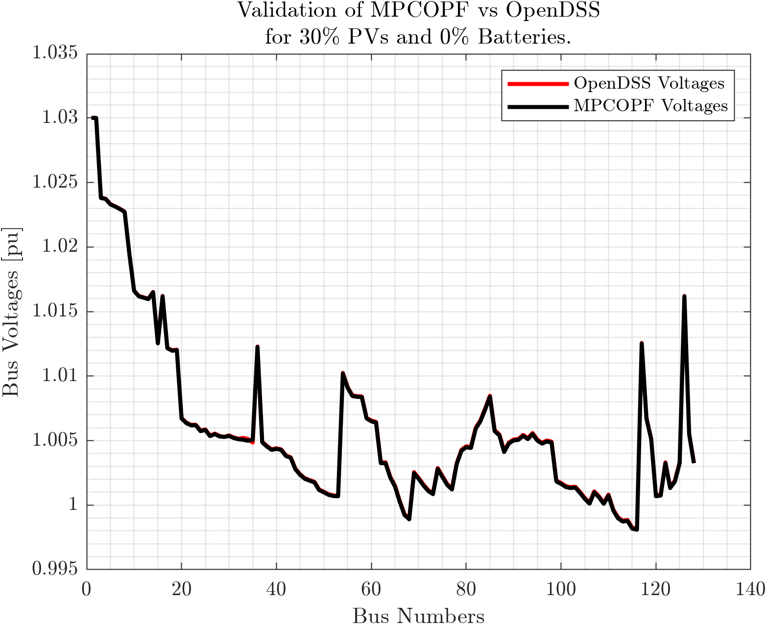
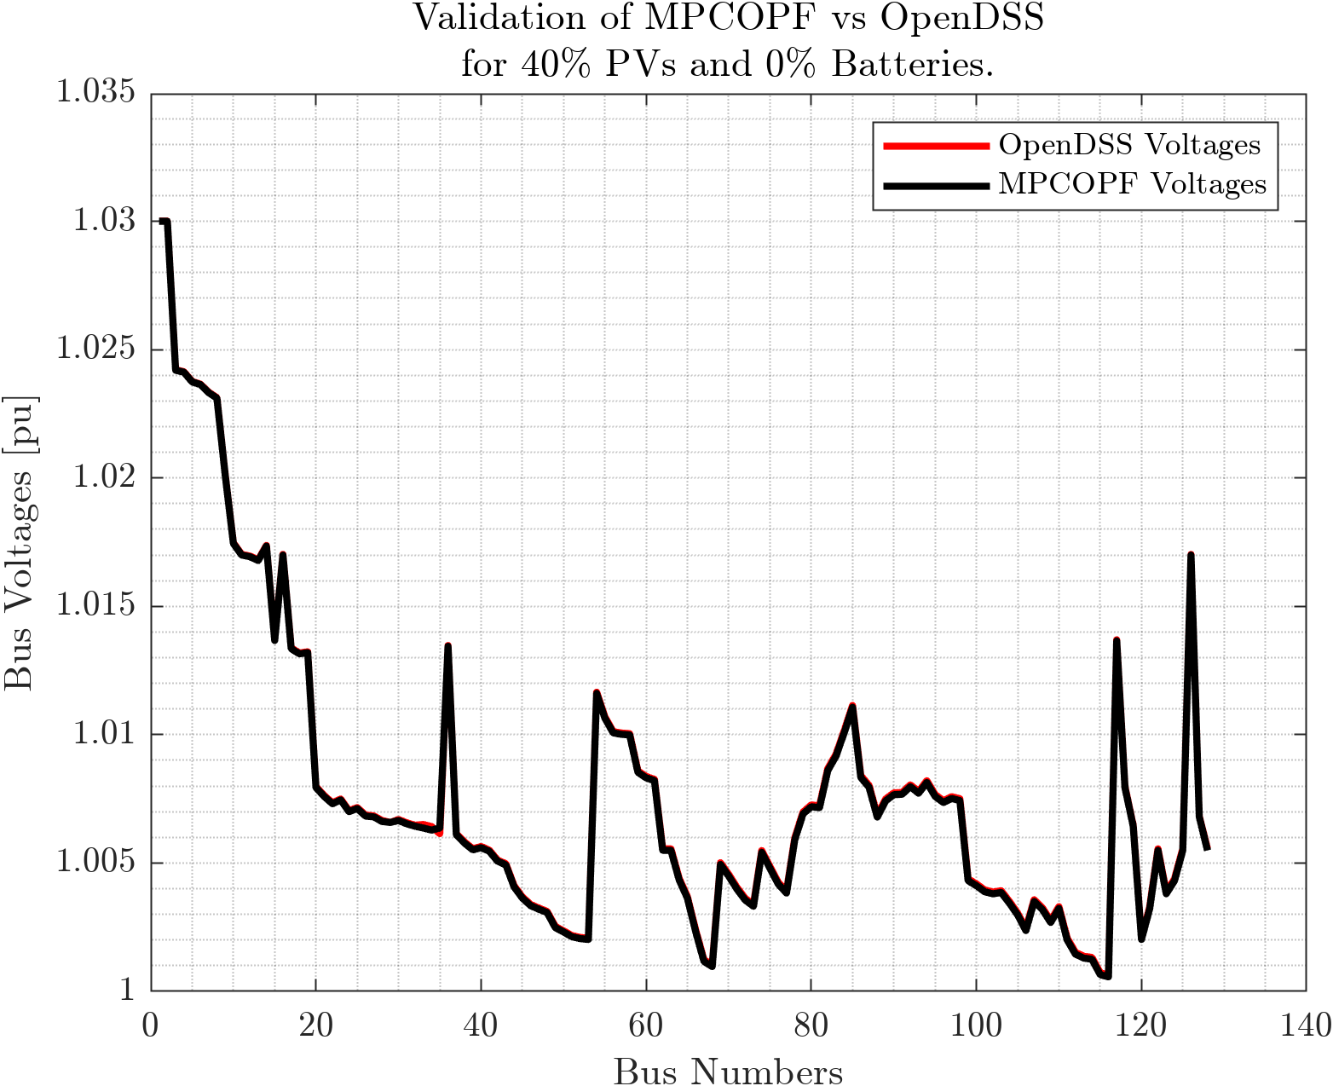
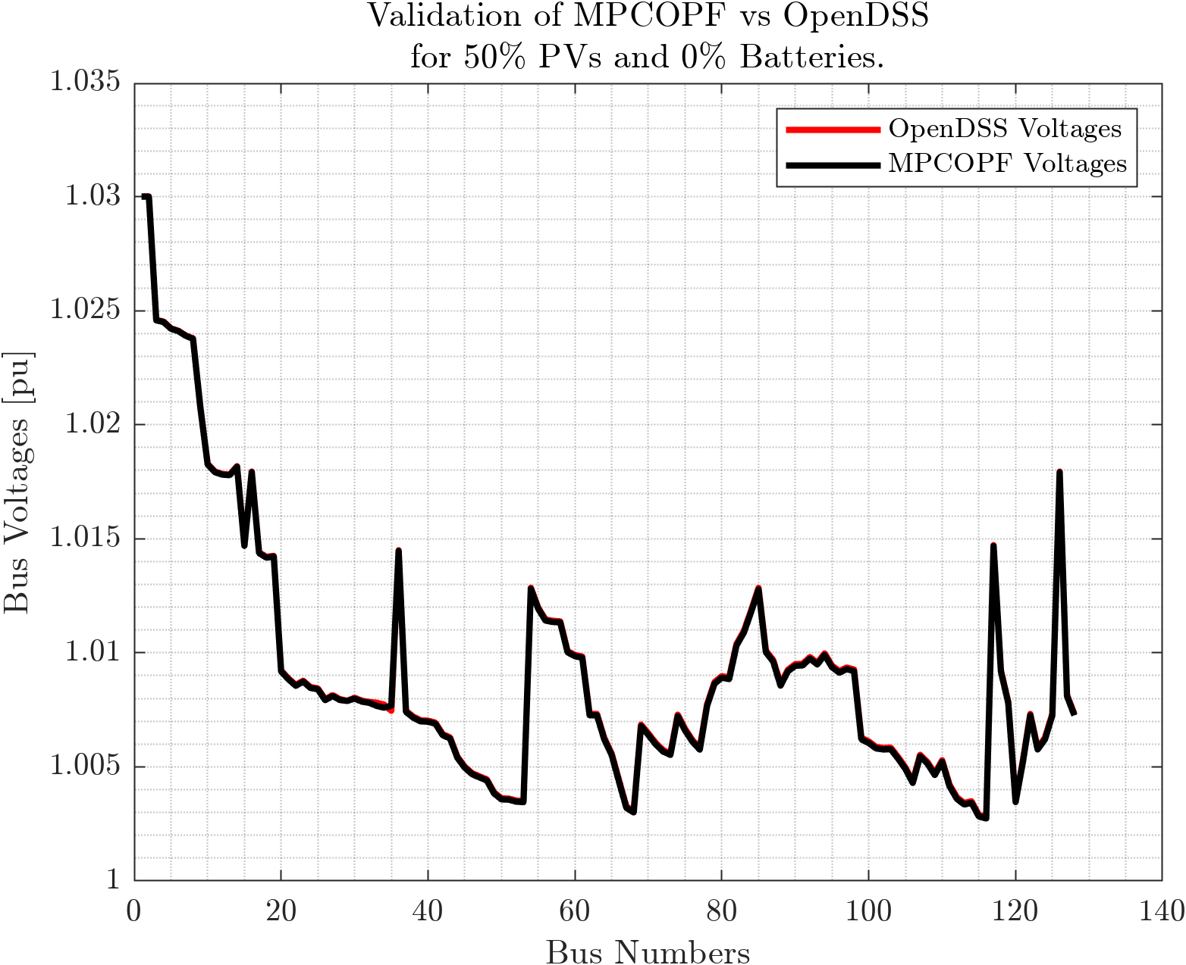

Comparison with OpenDSS: System-wide Voltage Snapshots PV = $0\%, 10\%, 20\%, 30\%, 40\%, 50\%$ Battery = $0\%$ $$T = 1$$

Slide 8
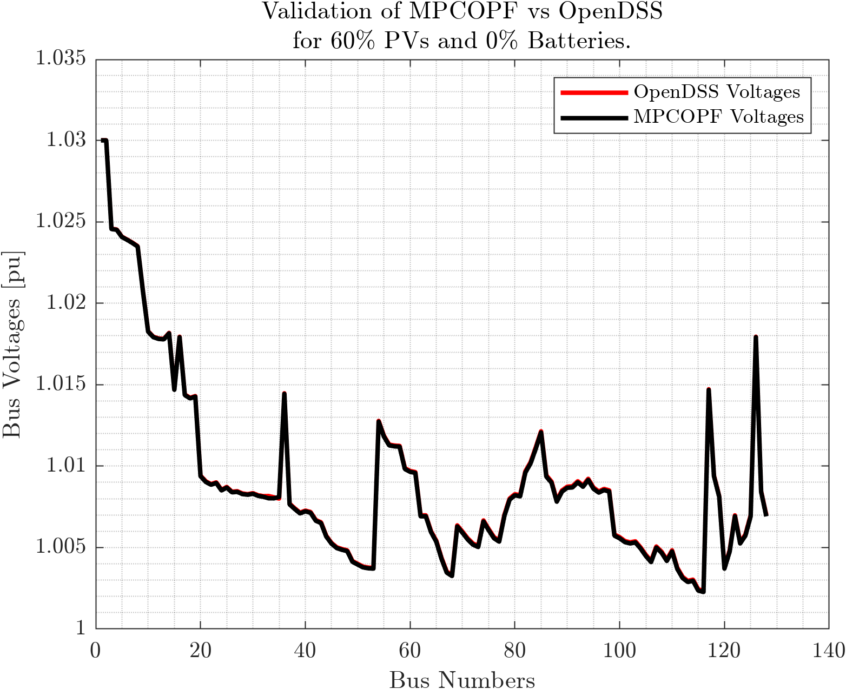
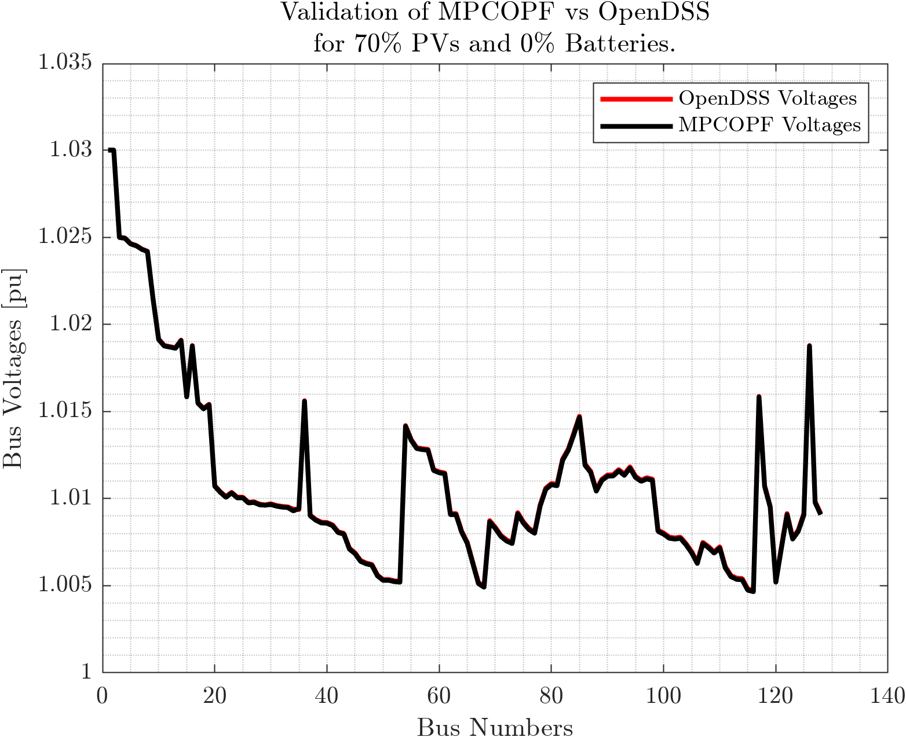
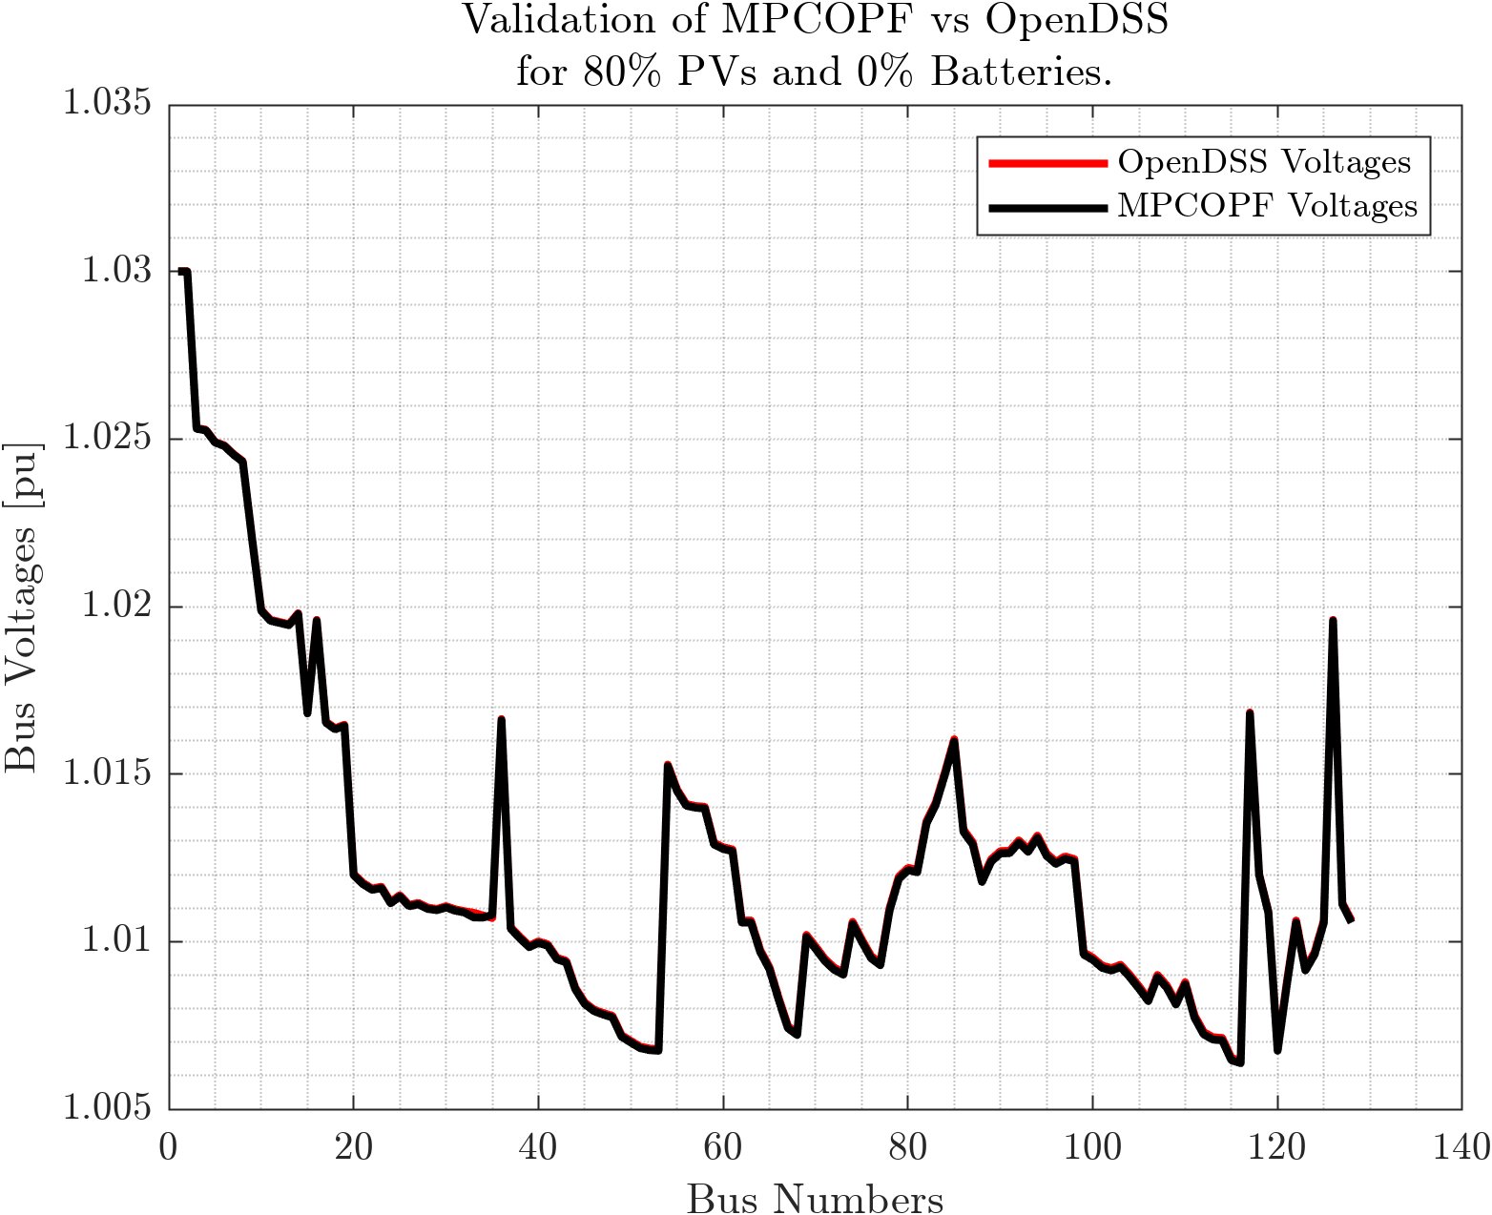
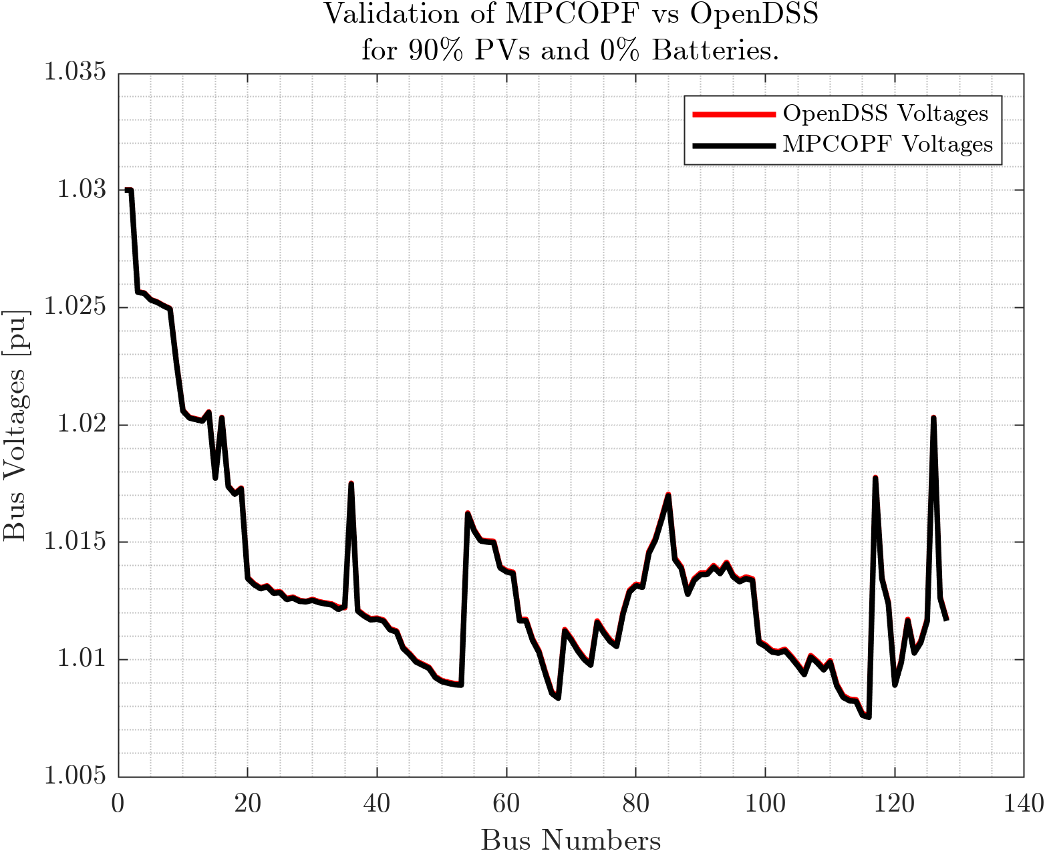
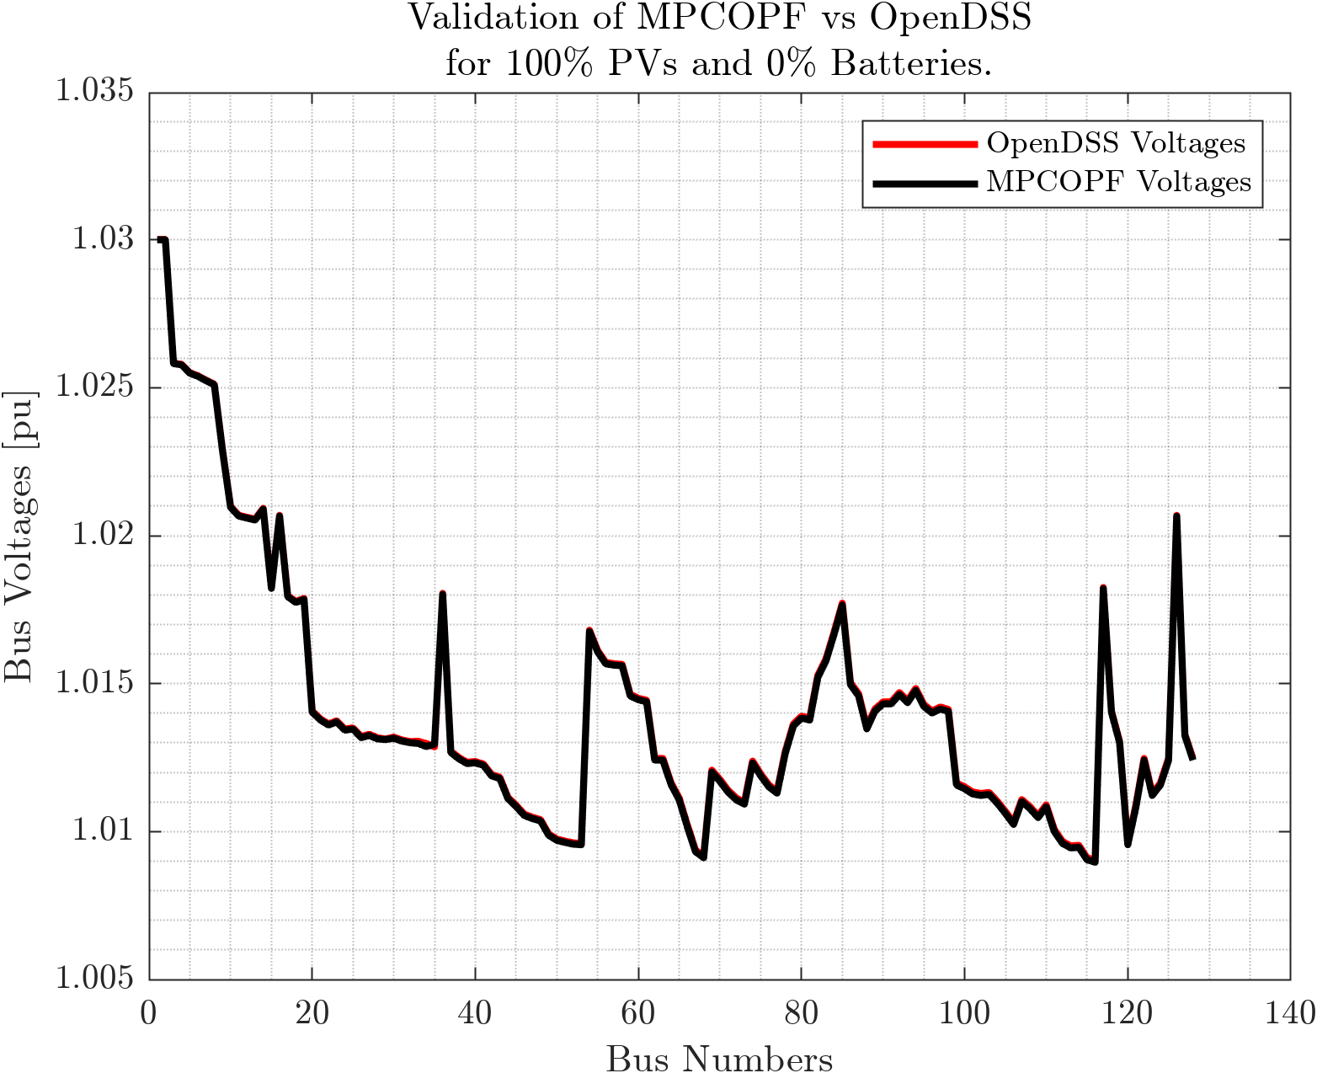

Comparison with OpenDSS: System-wide Voltage Snapshots PV = $60\%, 70\%, 80\%, 90\%, 100\%,$ Battery = $0\%$ $$T = 1$$

Slide 9

Comparison with OpenDSS: System-wide Voltage Snapshots Battery = $10\%, 20\%, 30\%, 40\%, 50\%$ PV = $0\%$ $$T = 1$$

Slide 10
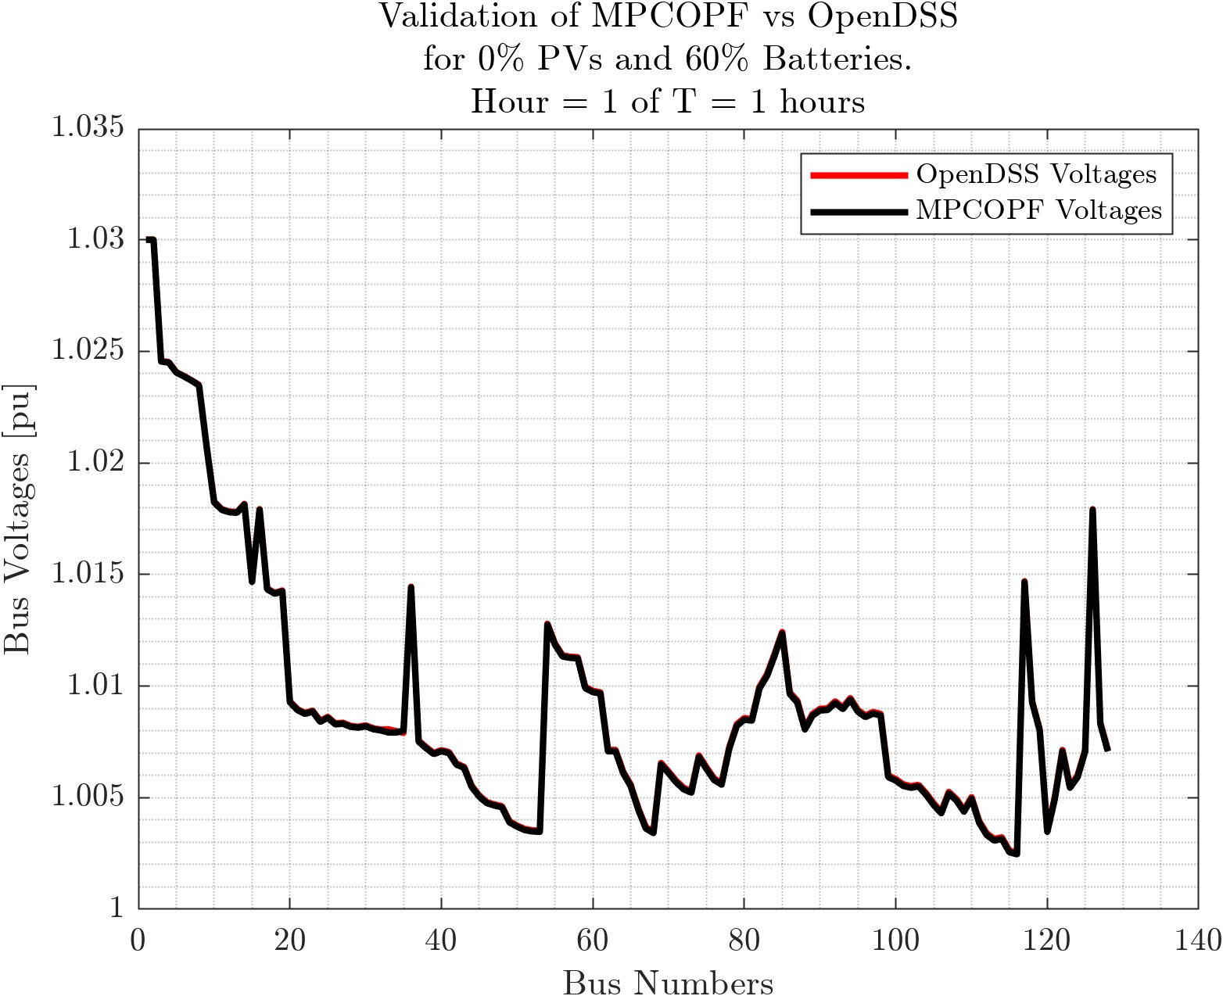
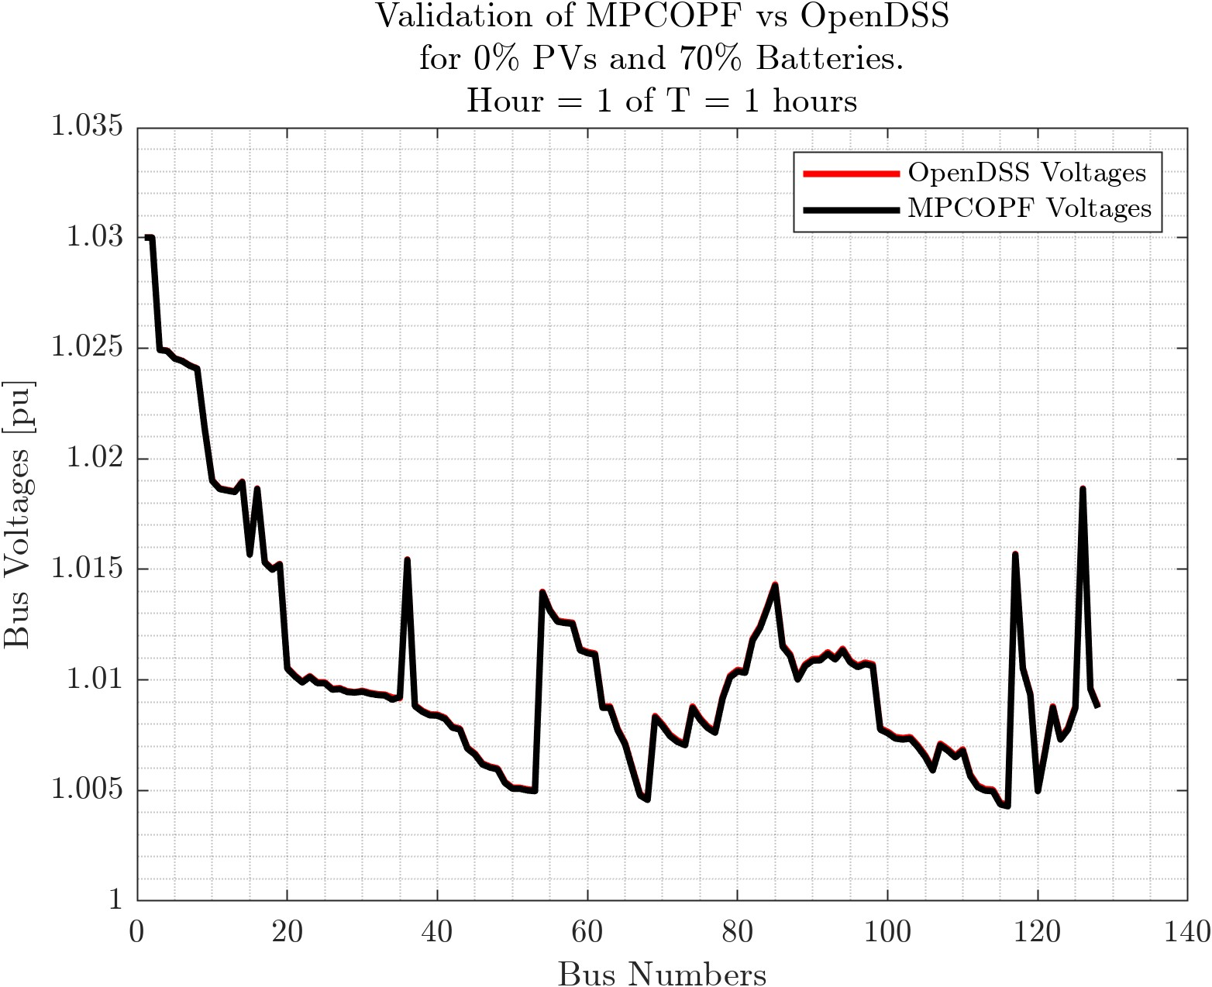
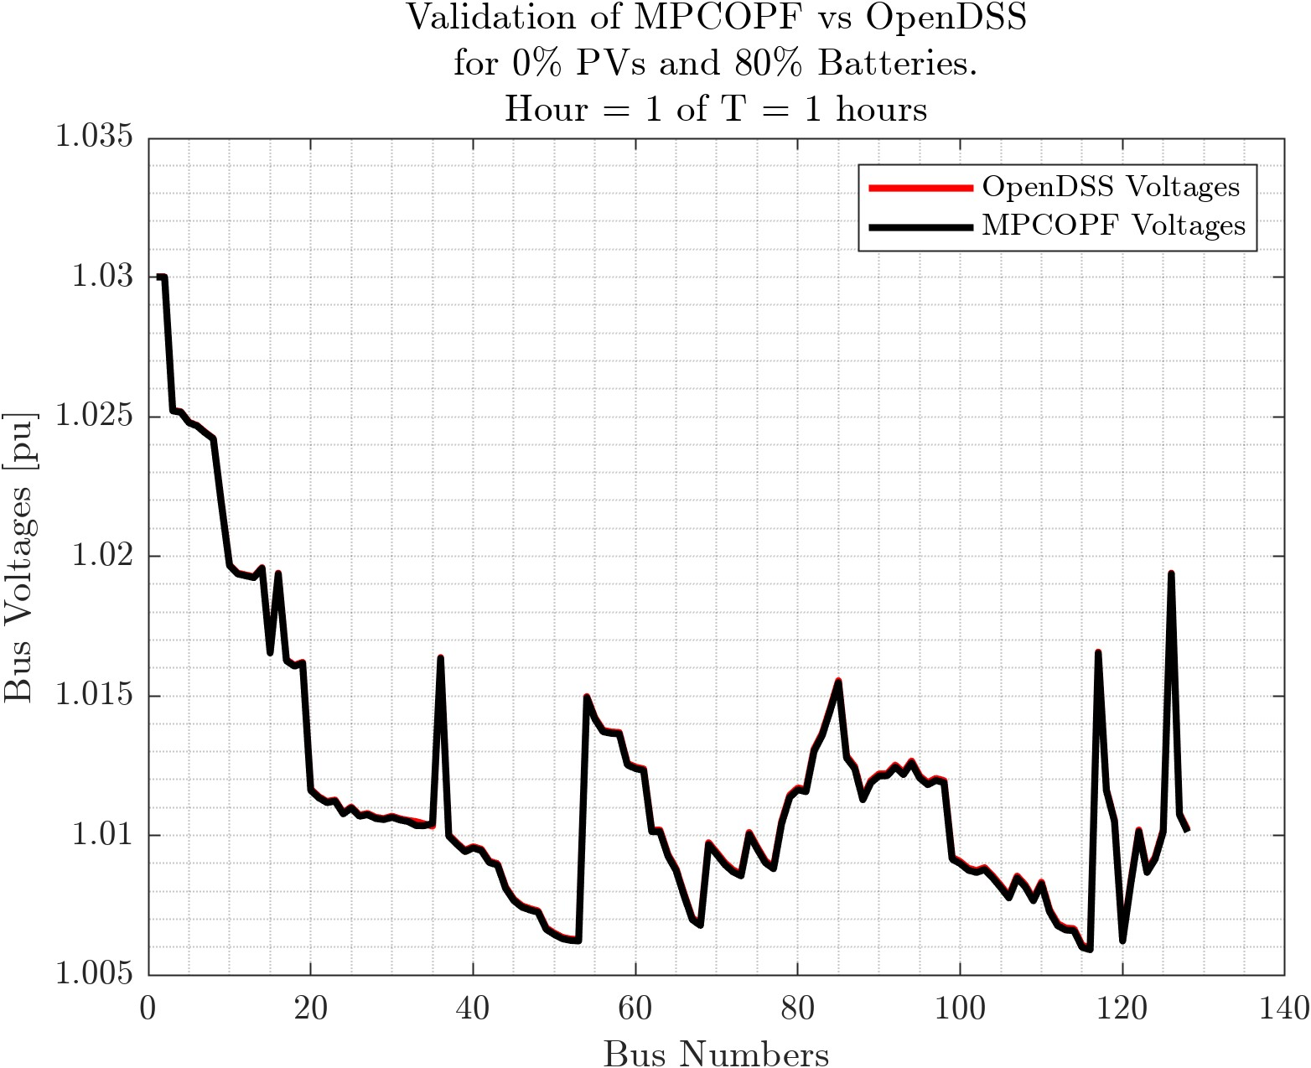
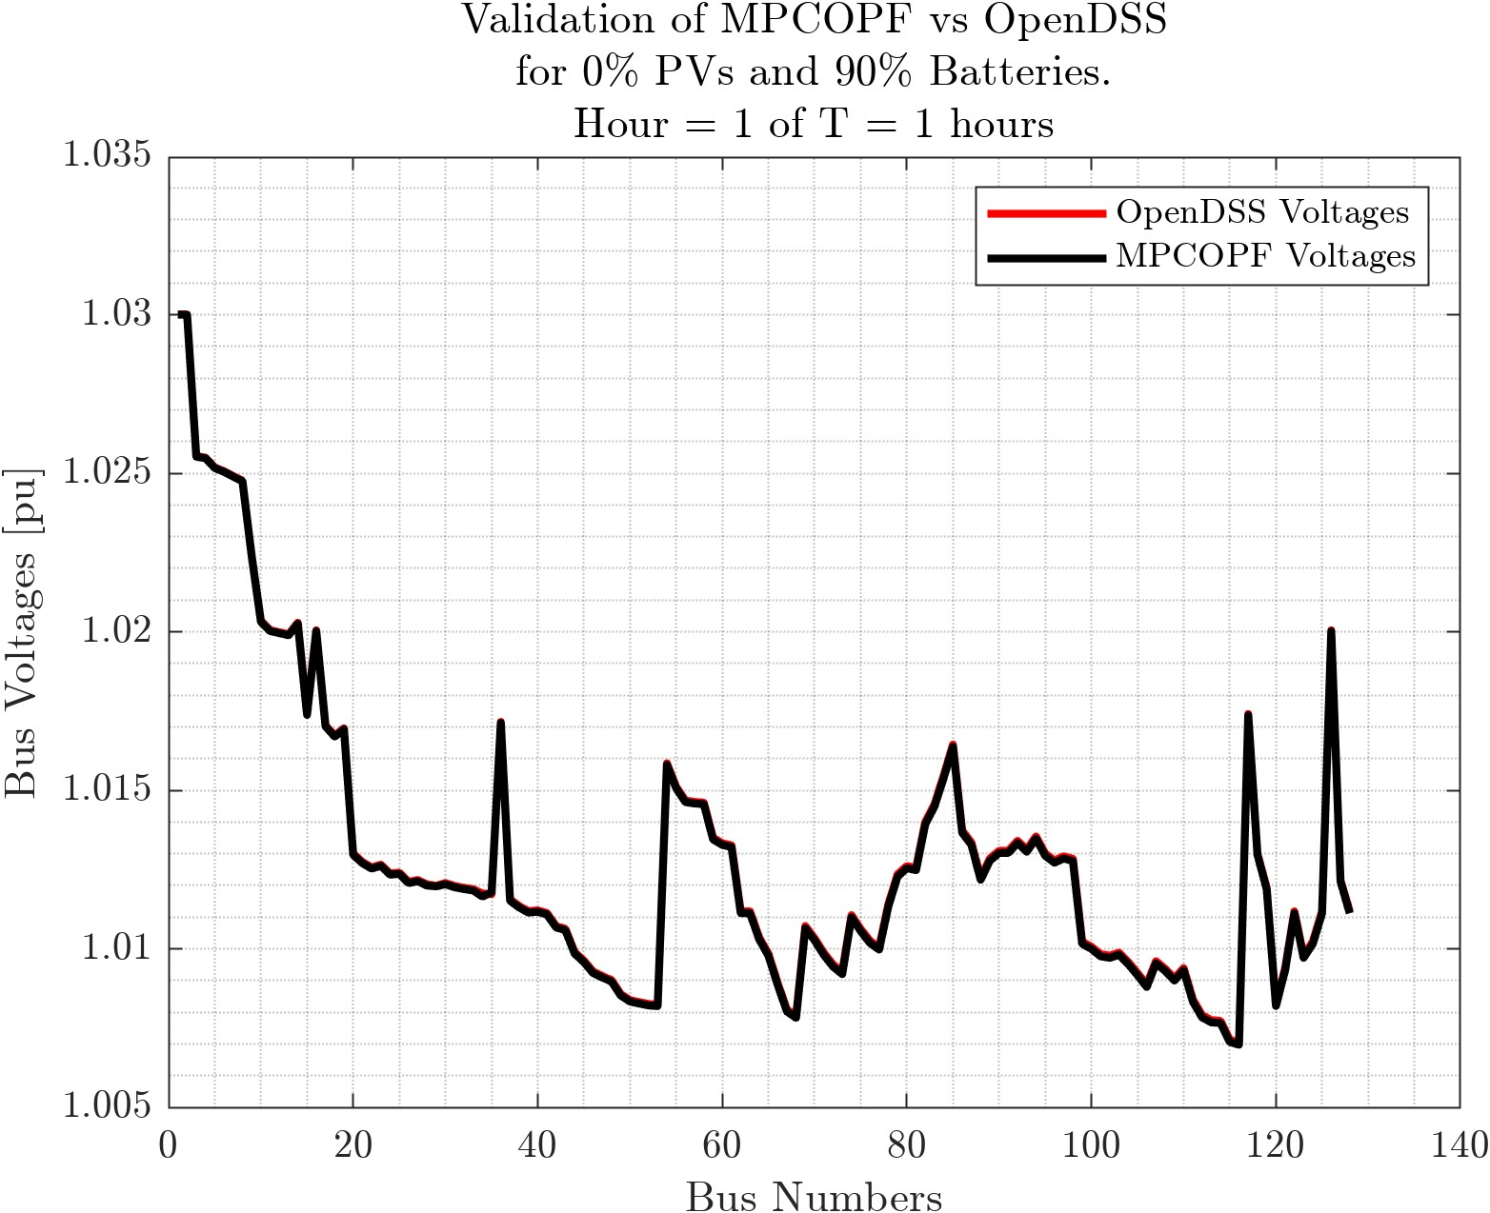
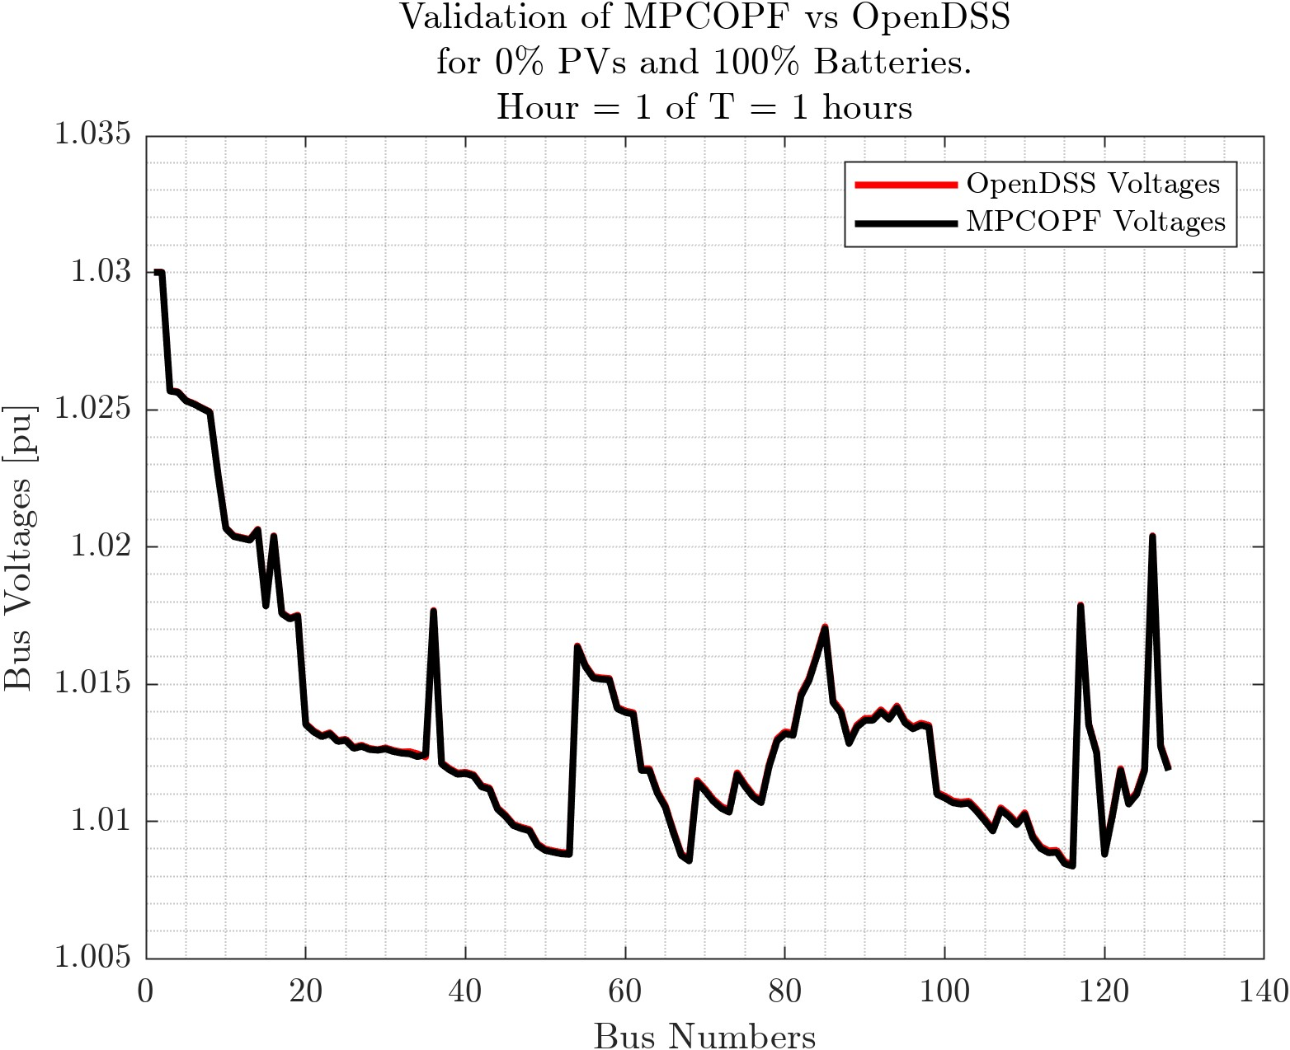

Comparison with OpenDSS: System-wide Voltage Snapshots
PV = $0\%$ Battery = $60\%, 70\%, 80\%, 90\%, 100\%,$ $$T = 1$$

Slide 11
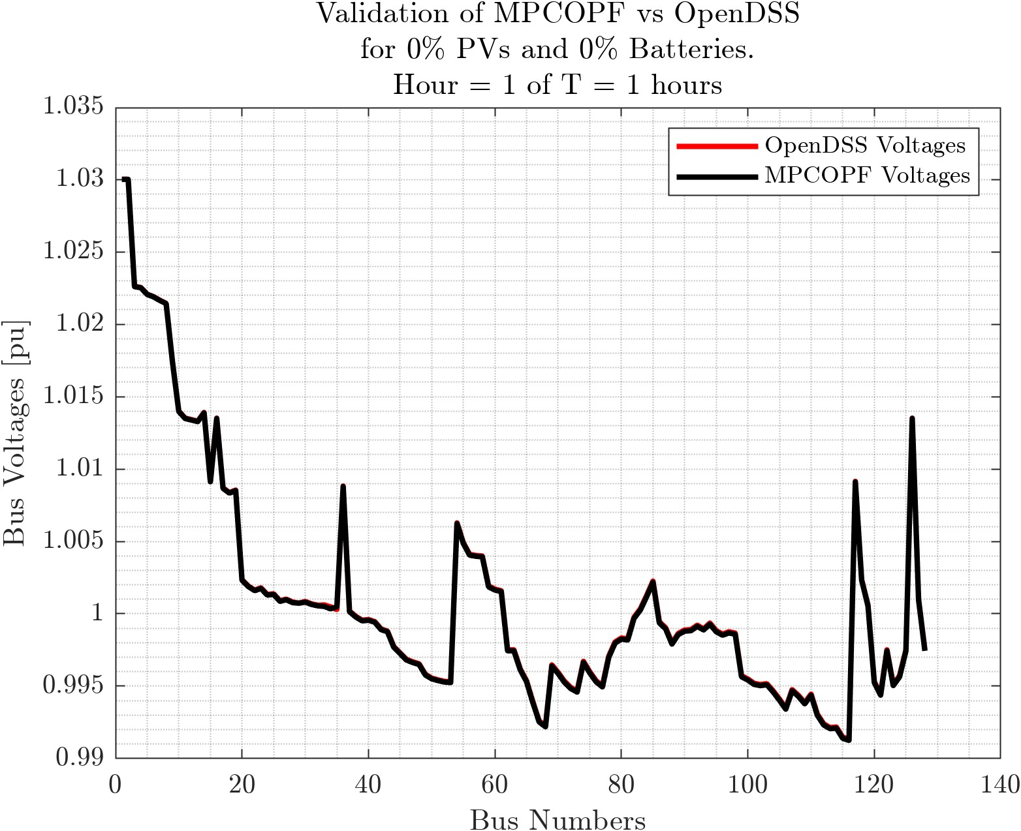
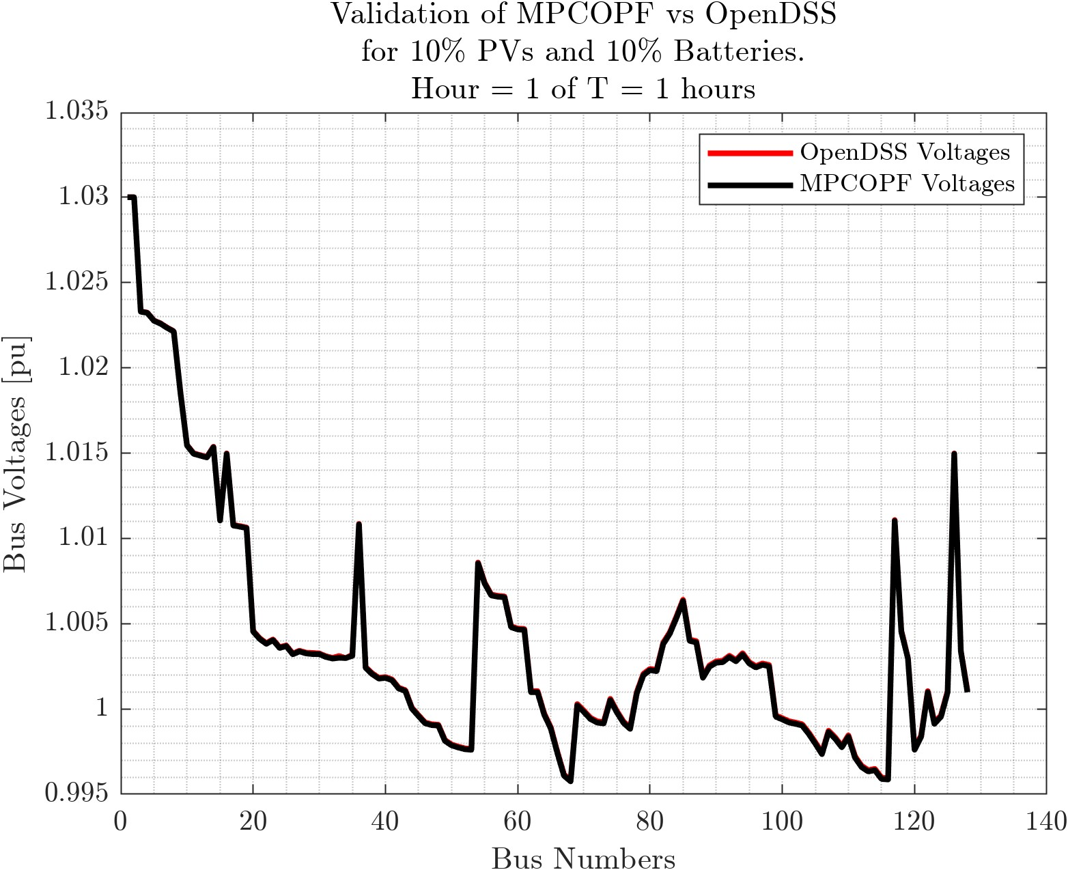
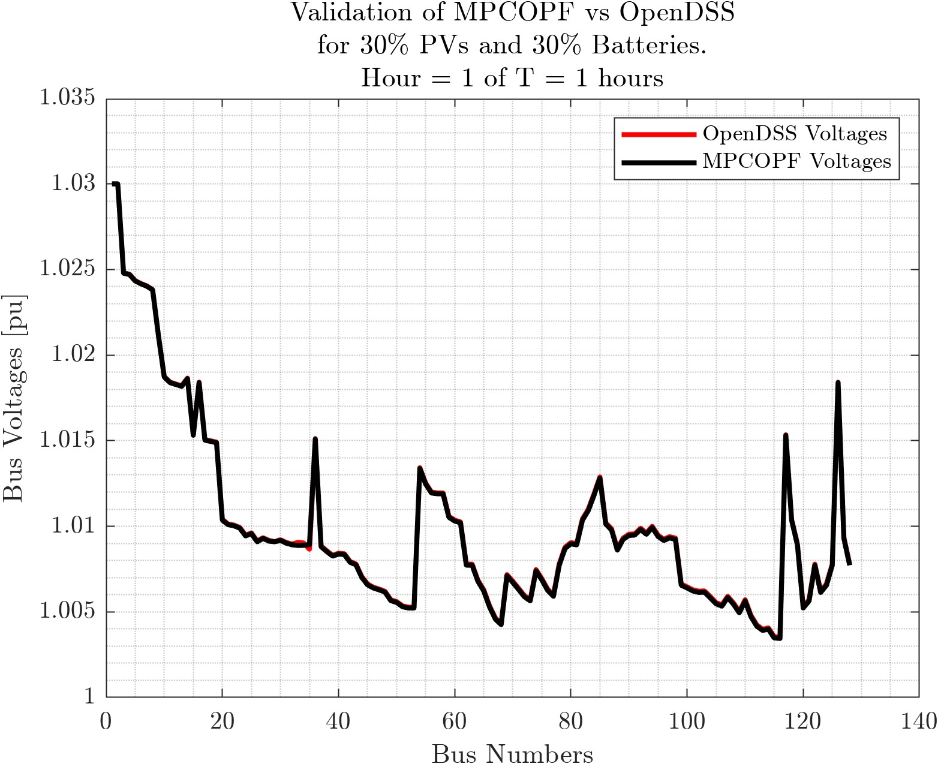
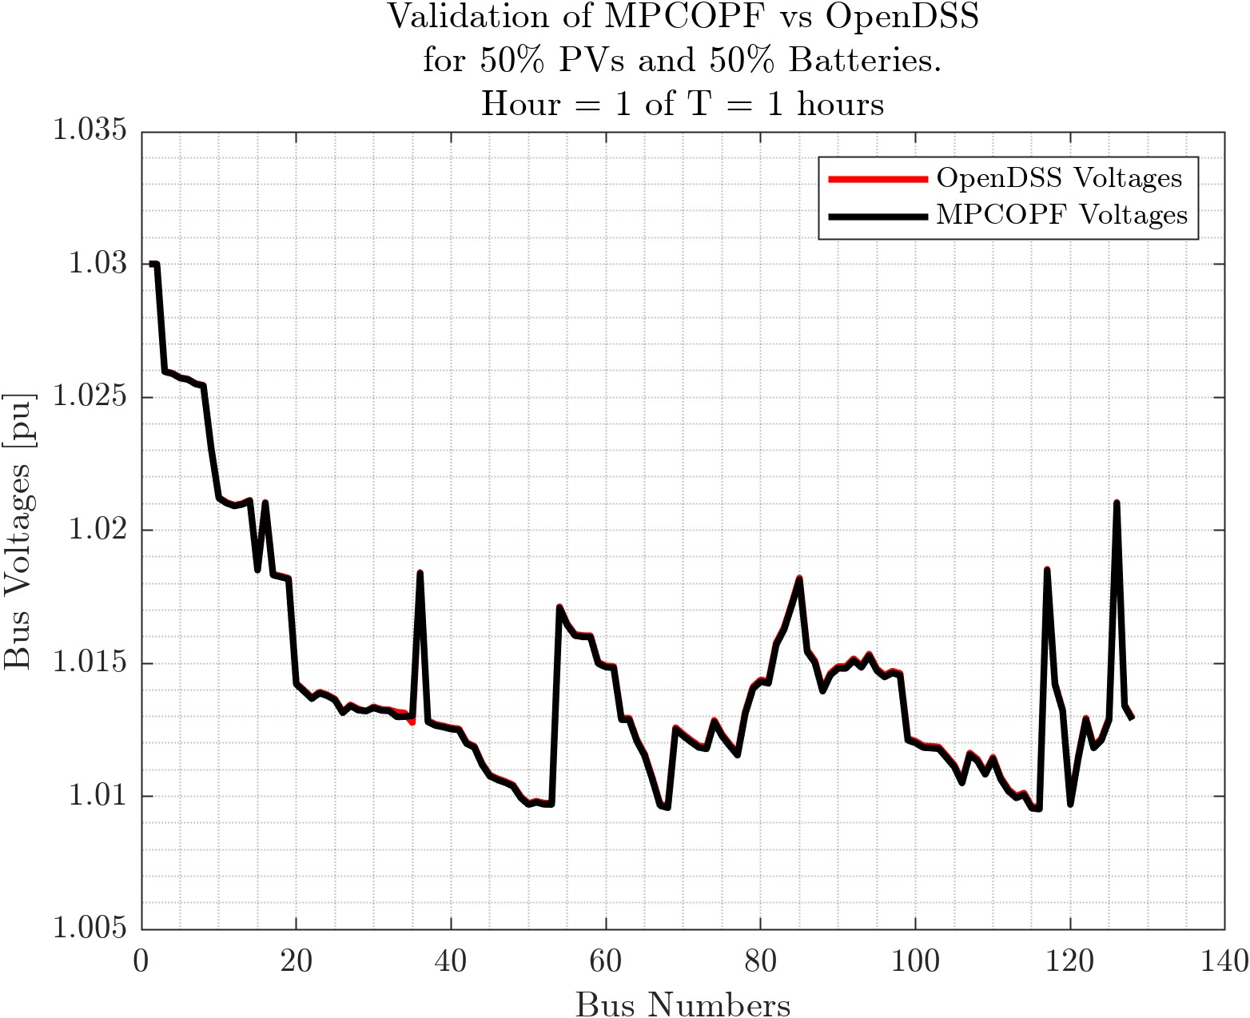
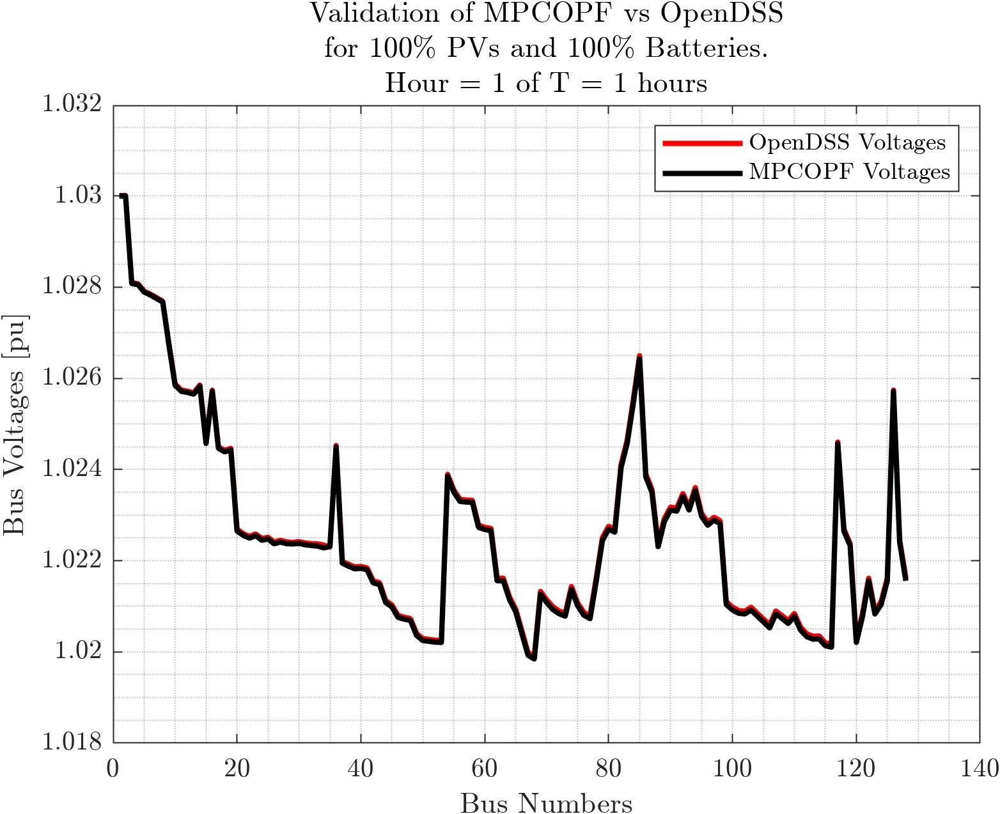

Comparison with OpenDSS: System-wide Voltage Snapshots
PV and Battery = $0\%, 10\%, 30\%, 50\%, 100\%$ $$T = 1$$

Slide 12
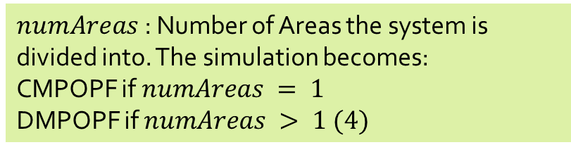
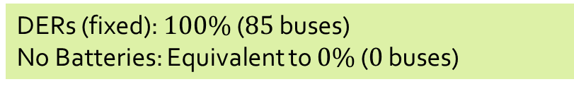



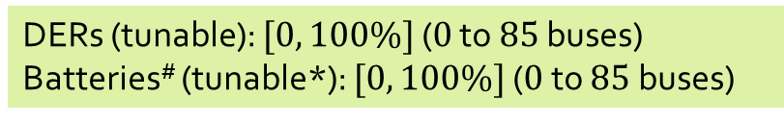
Trying to benchmark the “Benchmark” Simulation against the “Original” Simulation
$T$: Number of Time-Periods (tunable)
No Time-dimension: Equivalent to $T=1$
$numAreas$ : Number of Areas the system is divided into. The simulation becomes:
CMPOPF if $numAreas = 1$
DMPOPF if $numAreas > 1 (4)$
$numAreas$ : Number of Areas the system is divided into. The simulation becomes:
CMPOPF if $numAreas = 1$
DMPOPF if $numAreas > 1 (4)$
DERs (tunable): $[0, 100\%]$ ($0$ to $85$ buses)
Batteries# (tunable*): $[0, 100\%]$ ($0$ to $85$buses)
DERs (fixed): $100\%$ ($85$ buses)
No Batteries: Equivalent to $0\%$ ($0$ buses)
“Benchmark” Simulation: MP-(C/D)-OPF
“Original” Simulation: (C/D)-OPF

Slide 13
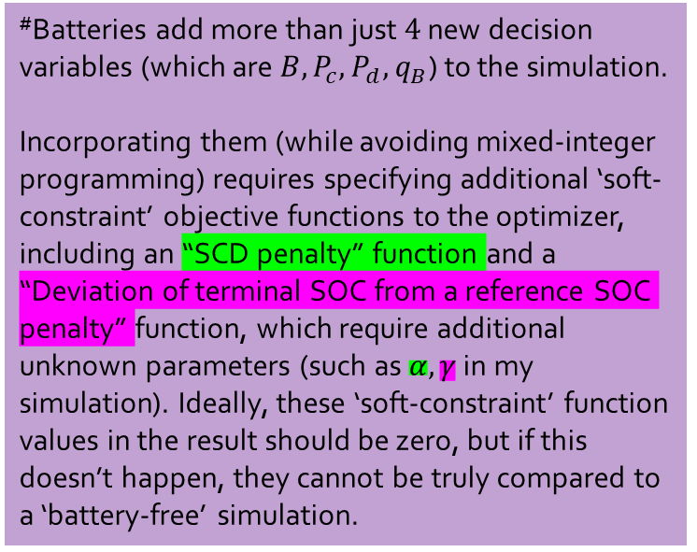
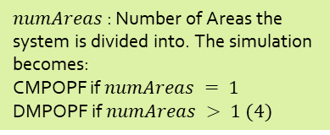


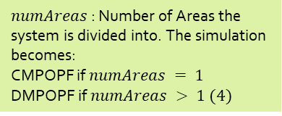

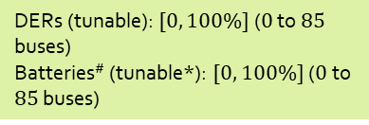
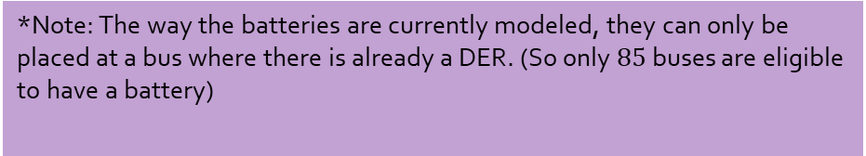
Trying to benchmark the “Benchmark” Simulation against the “Original” Simulation
#Batteries add more than just $4$ new decision variables (which are $B, P_{c}, P_{d}, q_{B}$) to the simulation.
Incorporating them (while avoiding mixed-integer programming) requires specifying additional ‘soft-constraint’ objective functions to the optimizer, including an “SCD penalty” function and a “Deviation of terminal SOC from a reference SOC penalty” function, which require additional unknown parameters (such as $α, γ$ in my simulation). Ideally, these ‘soft-constraint’ function values in the result should be zero, but if this doesn’t happen, they cannot be truly compared to a ‘battery-free’ simulation.
$T$: Number of Time-Periods (tunable)
No Time-dimension: Like $T=1$
$numAreas$ : Number of Areas the system is divided into. The simulation becomes:
CMPOPF if $numAreas = 1$
DMPOPF if $numAreas > 1 (4)$
$numAreas$ : Number of Areas the system is divided into. The simulation becomes:
CMPOPF if $numAreas = 1$
DMPOPF if $numAreas > 1 (4)$
DERs (tunable): $[0, 100\%]$ ($0$ to $85$ buses)
Batteries# (tunable*): $[0, 100\%]$ ($0$ to $85$buses)
DERs (fixed): $100\%$ ($85$ buses)
No Batteries: Like $0\%$ ($0$ buses)
“Benchmark” Simulation: MP-(C/D)-OPF
“Original” Simulation: (C/D)-OPF
*Note: The way the batteries are currently modeled, they can only be placed at a bus where there is already a DER. (So only $85$ buses are eligible to have a battery)

Slide 14
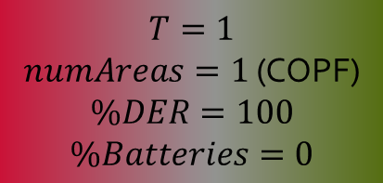
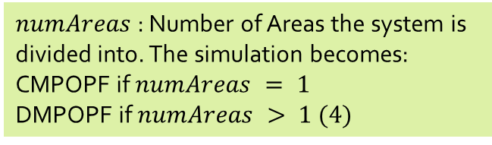
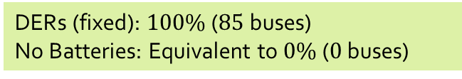

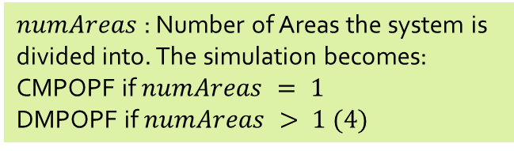


Trying to benchmark the “Benchmark” Simulation against the “Original” Simulation
But, if batteries are removed (unmodeled) from the MPOPF simulation, the previously mentioned complications are also avoided, and thus the two simulations can be compared toe-to-toe. This is what I’ve been doing recently.
$T$: Number of Time-Periods (tunable)
$$T=1$$
$numAreas=1$ (COPF)
$$\%DER=100$$
$$\%Batteries=0$$
No Time-dimension: Equivalent to $T=1$
$numAreas$ : Number of Areas the system is divided into. The simulation becomes:
CMPOPF if $numAreas = 1$
DMPOPF if $numAreas > 1 (4)$
$numAreas$ : Number of Areas the system is divided into. The simulation becomes:
CMPOPF if $numAreas = 1$
DMPOPF if $numAreas > 1 (4)$
DERs (tunable): $[0, 100\%]$ ($0$ to $85$ buses)
Batteries# (tunable*): $[0, 100\%]$ ($0$ to $85$buses)
DERs (fixed): $100\%$ ($85$ buses)
No Batteries: Equivalent to $0\%$ ($0$ buses)
“Benchmark” Simulation: MP-(C/D)-OPF
“Original” Simulation: (C/D)-OPF

Slide 15


IEEE $123 100\%$DER, $0\%$Batteries. COPF. $T = 1$
Current Status: My MPCOPF line loss result matches with the previous COPF line loss results, which still is a little off the OpenDSS line loss. Voltages (on the next page) match closely, but not completely. I don’t know the cause of the slight mismatch. (and whether it will blow up for bigger simulations, or not be an issue)
Multi-Period Simulation, T = 1, Batteries at 0%, DERs at 100% ($85$ buses)
OpenDSS Powerflow with DERs at 100% ($85$ buses)

Slide 16


Comparison with OpenDSS

Slide 17




IEEE $123 100\%$DER, $0\%$Batteries. COPF. $T = 1$
Problem: These values should be the same. This is an OPF modelling issue.
Multi-Period Simulation, T = 1, Batteries at 0%, DERs at 100% ($85$ buses)
Original Simulation* DERs at 100% ($85$ buses)
* Original Simulation = Simulation used by Rabayet to model DOPF on IEEE $123$ Bus System with $100\%$ DERs ($85$ buses). Obviously, there’s no element of time $($not modeled, so $T=1)$ and no batteries (not modeled, so $0\%$)

Slide 18

Current Approach: Validating OPF decision variables with OpenDSS
By setting
$P_{Load_OpenDSS}=P_{Load} −P_{DER} −P_{disch}+P_{chr}$
$Q_{Load_OpenDSS}=Q_{Load} −q_{DER} −q_{Batt}−Q_{Cap}$
Running Powerflow in OpenDSS, obtaining $V_{OpenDSS}$ and comparing against my simulation $V_{results}$ (checking for physical violations, but also, just checking the two $V$vs bus-number curves in general).
I’m writing an OpenDSS validator function, which takes busData, branchData, $P_{Load}, P_{DER}, P_{disch}, P_{chr}, Q_{Load}, q_{DER}, q_{Batt}, Q_{cap}, V_{results}$ for a given time-interval $t$and plots its powerflow voltages $V_{OpenDSS}$ against my $V_{results}$.

Slide 19

Comparison with OpenDSS confirms that the current MPCOPF model has issues

Slide 20


Network being tested on
Current problem statement
Test Case: IEEE123 Node System with Distributed Energy Resources (DERs) and Batteries.
Balanced three-phase (with no phase coupling, akin to single-phase) power distribution network.
Objective: Solve for Optimal Power Flow (OPF) for a horizon time interval of $T$for a given objective function, say loss minimization.

Slide 21




Network being tested on
A previous model of the test system. Currently the system has DERs and Batteries on $100\%$ of the nodes with non-zero loads.
ENApp Approach [1]
Divide the network into several areas to solve for their Optimal Power Flow solutions separately, with exchange of boundary variables after every ‘macro-iteration’.

Slide 22

Overall Scope of the problem Algorithm and Communication Architecture
OpenDSO-System Operator (Forecast)
OpenDSO-Measurement Devices
OpenDSO-EDO
OpenDSO-OpenDSO

Slide 23

A simpler schematic for D-OPF.

Slide 24


A simpler schematic for MP-D-OPF for three time-steps
($T=3)$

Slide 25

What is currently being done? MP-DOPF in Brute Force

Slide 26



What is will be done? A ‘true’ MP-DOPF using Differential Dynamic Programming (Currently under formulation, variables not explained here) [20b]
$$μ_{1}$$
$$μ_{2}$$

Slide 27

Multi-Period D-OPF simulation of a grid with DERs and Battery Storage

Slide 28

Problem Statement
Given the State of Charges of all batteries in a grid at the beginning of a horizon interval ($B_{j}^{0}, j∈ ℬ, ℬ$ representing the set of nodes with Batteries$)$, along with predictions for other non-controllable parameter values like $P_{Load}^{t}, P_{DER}^{t} ∀ t∈\left[0, T\right]$:
Solve for Optimal Power Flow of the system, with the objective of minimizing line losses across the entire horizon of time interval $T$

Slide 29

Problem Statement
Given the State of Charges of all batteries in a grid at the beginning of a horizon interval ($B_{j}^{0}, j∈ ℬ, ℬ$ representing the set of nodes with Batteries$)$, along with other non-controllable parameter values like $P_{Load}, P_{DER}$:
Solve for Optimal Power Flow of the system, with the objective of minimizing line losses across the entire horizon of time interval $T$
while making sure that:
1. $B_{t}$ (the SOC of the battery at every point of the simulation) stays in permissible limits
2. The OPF Solution is physically consistent. For no node containing a battery, is $P_{d}^{t}. P_{c}^{t}≠0$. In other words, make sure that Complementarity of Discharging and Charging is ensured. Alternatively, Simultaneous Charging and Discharging (SCD) is avoided.
3. Other usual OPF physical constraints are also satisfied.
4. Terminal SOC is same as initial.

Slide 30

Simulation Parameters
Objective: Minimize Line Losses (Greedily)
System: IEEE $123$ Node System
Phase: Balanced $3∅$
Supply: DERs and Batteries at select (about $50\%$ of total) nodes. Substation.
Demand: Flat line (will be made varying each time-step in future simulations)
Control: Inverter Reactive Power Control for DERs and Batteries. Battery Charging/Discharging.
Number of discrete time-steps: $K= 7$
Duration per time-step: $Δt=15$min.

Slide 31

Simulation Process
Start
$$t=1$$
$B\left(t=1\right)=50\%$ mark within the permissible range.
while $t≤K$
Batteries start with state $B(t)$ at the beginning of the time interval.
Run (D-)OPF for minimizing the losses during current time interval $(t$to $t+1)$
Batteries reach a state $B\left(t+1\right)$ after the end of the interval, as per the optimal solution.
Repeat with $t=t+1$.
end

Slide 32


Optimization Formulation
(Integer-Constraint Relaxed) Non-linear Optimization Problem: BFM Constraints with Battery and DER decision variables.
Line Losses
Real Powerflow from a bus into the network
Reactive Powerflow from a bus into the network
Kirchhoff's Voltage Law (KVL)
Current Magnitude in a branch

Slide 33

Optimization Formulation
(Integer-Constraint Relaxed) Non-linear Optimization Problem: BFM Constraints with Battery and DER decision variables.
Line Losses
DER Inverter Reactive Power
Nodal Voltage Limits

Slide 34

Optimization Formulation
(Integer-Constraint Relaxed) Non-linear Optimization Problem: BFM Constraints with Battery and DER decision variables.
Line Losses
Battery State of Charge Equation (this equation is temporally coupled, or has ‘memory’)

Slide 35

Optimization Formulation
(Integer-Constraint Relaxed) Non-linear Optimization Problem: BFM Constraints with Battery and DER decision variables.
Line Losses
Battery Charging and Discharging Power Limits
Battery Inverter Reactive Power Limits
Battery SOC Permissible Limits

Slide 36

Optimization Formulation
(Integer-Constraint Relaxed) Non-linear Optimization Problem: Tweaking the Objective Function to satisfy some more constraints.
Line Losses
Ensures Complementarity of Charging and Discharging, or alternatively, ensure there’s no SCD.
For minimizing the deviation between end-of-day battery SOC and a reference SOC.

Slide 37


Optimization Formulation
(Integer-Constraint Relaxed) The Full Non-linear Optimization Problem
Line Losses
For minimizing the deviation between end-of-day battery SOC and a reference SOC.
Ensures Complementarity of Charging and Discharging, or alternatively, ensure there’s no SCD.
Real Powerflow from a bus into the network
Battery State of Charge Equation (temporally coupled) with complementarity relaxed.
Reactive Powerflow from a bus into the network
#Types of variables
$$9T$$
#Variables
$$4mT+n_{DERT}T+4n_{Batt}T$$
#Equality Constraints $4mT+n_{Batt}T$
(Non-Linear)
Kirchhoff's Voltage Law (KVL)
Current Magnitude in a branch
DER Generation (forecasted, non-controllable)
Loads (forecasted, non-controllable)

Slide 38

Current Status of Simulation and Results
What has been done
A variety of simulation runs have been modelled and run for the sake of benchmarking including:
Centralized OPF with and without batteries ($T$ time-steps).
Distributed* OPF with and without batteries. ($T \text{time}\text{−}\text{steps}, 4$ Areas)
*Spatially Distributed Computation, Brute-forced Temporal Computation.
Previous: Distributed OPF with batteries in a greedy “minimize losses right this time-period, for every time-period” manner. ($4$ Areas, $T$ time-steps)

Slide 39

Results: Boundary Variables
$P_{Losses}$vs $t$

Slide 40



Results: Boundary Variables
$P_{12}$vs $t$

Slide 41



Results: Boundary Variables
$V_{1}$ vs $t$

Slide 42


Current Status of Simulation and Results
SCD Plots to check Physical validity of Distributed MPOPF
This simulation was done for 5 time-steps (but the algorithm is scalable, and I’ve done them for 10, 15 time-steps. But the time taken by the brute force algorithm grows exponentially with number of time steps)
Charging and Discharging are always Complementary.
Terminal SOC is almost the same as initial SOC

Slide 43


Current Status of Simulation and Results
Results for $123$ Node System from Centralized MPOPF
The plot shown is typical of the charging/discharging cycle for most batteries in the area.
This simulation was done for 5 time-steps (but the algorithm is scalable, and I’ve done them for 10, 15 time-steps. But the time taken by the brute force algorithm grows exponentially with number of time steps)
Charging and Discharging are always Complementary.
Terminal SOC is almost the same as initial SOC
IEEE $123$ Node System modelled here has $85$ nodes with Nodes and DERs and Batteries.

Slide 44

Current Status of Simulation and Results
Results for $123$ Node System from Centralized MPOPF

Slide 45
Conclusion and Discussion
Major Observations:
Batteries were modelled correctly, i.e. no Simultaneous Charging and Discharging was observed.
Terminal SOC values (SOC values at end of day) mostly kept close to the original SOC values (beginning of day).

Slide 46

Bounds and Values
Battery State/Control Variables (1/2)

Slide 47

Bounds and Values
Battery State/Control Variables (2/2)

Slide 48

Bounds and Values
BFM and DER State/Control Variables

Slide 49

Reference of Notation: Battery Variables

Slide 50

Reference of Notation: BFM and DER Variables

Slide 51

Reference of Notation: Grid-level Notation
Helpful for clarifying any variable in the optimization formulations.

Slide 52

Reference of Notation: Branch Flow Model and DER variables
Helpful for clarifying any variable in the optimization formulations.

Slide 53




(IEEE 123 System divided into) 4 Area System

Slide 54

[In development] Simulation Process of Spatially and Temporally Decomposed OPF algorithm.
start
------------------------------------------------------------------------
Known:
$B_{j}^{0}, P_{DER_{j}}^{t}, P_{Load_{j}}^{t} ∀ t∈\left[0, T\right], j∈Ν$
-----------------------------------------------------------------------
while “temporal boundary variables are NOT equal in value for all consecutive time intervals”
while “spatial boundary variables are NOT equal in value for all connected parent-child areas”
Run (D-)OPF for minimizing the losses across the horizon for each area, in parallel. This is called as a macro-iteration.
Exchange spatial boundary variables between all sets of connected parent-child areas.
end
Exchange temporal boundary variables between consecutive time intervals
end
------------------------------------------------------------------------
stop

Slide 55

Optimization Formulation
Mixed-Integer Non-linear Optimization Problem (in built-complementarity, but harder to solve)
Line Losses
Battery State of Charge Equation (this equation is temporally coupled, or has ‘memory’)
Real Powerflow from a bus into the network
Reactive Powerflow from a bus into the network
Kirchhoff's Voltage Law (KVL)
Current Magnitude in a branch
Complementarity of Charging and Discharging during a particular time interval.
DER Generation (forecasted, non-controllable)
Loads (forecasted, non-controllable)

Slide 56
Multi-Period D-OPF simulation of a grid with DERs and Battery Storage
Currently it’s a series of single period D-OPFs, being solved for greedily.
Battery State of Charge (SOC) is ‘memorized’ by the grid after every time step, so a meaningful simulation is run for ‘Multi-time period’, even though the optimization itself is NOT done over the whole horizon.
Naïve Brute-Force approach to MPOPF being implemented (Solve for the full problem for the full horizon in one go).

Slide 57


Optimization Formulation
The Full Optimization Problem for Brute-Force MPOPF
#Types of variables
$$9T$$
#Variables
$$4mT+n_{DERT}T+4n_{Batt}T$$
#Equality Constraints $4mT+n_{Batt}T$
(Non-Linear)

Slide 58

Optimization Formulation
The Full Optimization Problem for Brute-Force MPOPF
#Types of variables
$$9T$$
#Variables
$$4mT+n_{DERT}T+4n_{Batt}T$$
#Equality Constraints $4mT+n_{Batt}T$
(Non-Linear)

Slide 59



Optimization Formulation
The Full Optimization Problem
SCD Term (Green Box)
Fixed values $P_{Load}, P_{DER}$ accounted for into $p_{j}$.
#Types of variables
$$9$$
#Variables
$$4m+n_{DER}+4n_{Batt}$$
#Equality Constraints $4m+n_{Batt}$
(Non-Linear)

Slide 60

Optimization Formulation
Will happen when every node has a DER and a Battery
The Full Optimization Problem: Linear Objective, Non-Linear Constraint
SCD Term (Green Box)
Fixed values $P_{Load}, P_{DER}$ accounted for into $p_{j}$.
Most Complicated Scenario Possible
#Types of variables
$$9$$
#Variables
$$9m$$
#Equality Constraints $5m$ (Non-Linear)

Slide 61

Optimization Formulation
Want to start with a good initialization for all $9$ state/control variables.
So should solve for some ‘simpler’ Optimization Problems.
The Full Optimization Problem: Linear Objective, Non-Linear Constraint
Most Complicated Scenario Possible
#Types of variables
$$9$$
#Variables
$$9m$$
#Equality Constraints $5m$ (Non-Linear)

Slide 62


Optimization Formulation
Start with removing some terms form the problem.
We hope to get good initialization values for the more complex problems.
Making a simpler Optimization Problem
Most Complicated Scenario Possible
Typo. Signs are flipped.
#Types of variables
$$9$$
#Variables
$$9m$$
#Equality Constraints $5m$ (Non-Linear)
Typo: Times are actually $t$ and $t−1$ instead of $t+1$ and $t$

Slide 63

Optimization Formulation
Class of Variable | Reason for Ignoring
 | Removing Losses makes model linear.
 | Side effect of the combined effect of current SCD term and type of objective function. Not including the Green Box Term can cause SCD. But adding the Green Box term without any loss term in the objective function basically penalizes any kind of battery participation.
Current/Loss Term
Making a simpler Optimization Problem
Battery Variables
Most Complicated Scenario Possible
Typo. Signs are flipped.
#Types of variables
$$9$$
#Variables
$$9m$$
#Equality Constraints $5m$ (Non-Linear)
Typo: Times are actually $t$ and $t−1$ instead of $t+1$ and $t$

Slide 64



Optimization Formulation
Initialization Step 1a: Feasibility on Linear Constraints
#Types of variables
$$4$$
#Variables
$$3m+n_{DER}$$
#Equality Constraints $3m$ (Linear)
Get feasible values of $v_{j}, P_{ij}, Q_{ij}, q_{D_{j}}$

Slide 65

Optimization Formulation
Initialization Step 1a: Feasibility on Linear Constraints
Most Complicated Scenario Possible
#Types of variables
$$4$$
#Variables
$$4m$$
#Equality Constraints $3m$ (Linear)
Get feasible values of $v_{j}, P_{ij}, Q_{ij}, q_{D_{j}}$

Slide 66


Optimization Formulation
Initialization Step 1b: Quadratic Objective, Linear Constraints
#Types of variables
$$8$$
#Variables
$$3m+n_{DER}+4n_{Batt}$$
#Equality Constraints $3m+n_{Batt}$ (Linear)

Slide 67



Optimization Formulation
A ‘fake’ line-loss function. We don’t want to involve $l_{ij}$ already as we’re yet to get good initialization for any of the Battery Variables.
We use $v_{j}$ results from Initialization Step $1a$. We can’t involve $v_{j}$ as an optimization variable as that would make the ‘fake’ loss minimization function non-convex.
Initialization Step 1b: Quadratic Objective, Linear Constraints
#Types of variables
$$8$$
#Variables
$$3m+n_{DER}+4n_{Batt}$$
#Equality Constraints $3m+n_{Batt}$ (Linear)

Slide 68

Optimization Formulation
Initialization Step 1b: Quadratic Objective, Linear Constraints
Most Complicated Scenario Possible
#Types of variables
$$8$$
#Variables
$$8m$$
#Equality Constraints $4m$ (Linear)

Slide 69

Bounds and Values
Battery State/Control Variables

Slide 70


Bounds and Values
$α$ – The Coefficient for the Green Box term penalizing SCD

Slide 71



Results: Real Power Losses
$P_{Losses}, P_{Subs}$ vs $t$
While batteries have charge to spare, the losses are minimized, as less power needs to flow all the way from the substation.
Here, for the first $4$ time-periods, or $60 min.$, the batteries are able to discharge at their maximum capacity, and so the line losses are significantly lower. By $6$ time-periods, they completely run out of SOC (reach minimum value of SOC), and the losses return to ‘normal’, pre-battery configuration.

Slide 72




A metric for quantifying effect of storage and DER power on the grid.
$$P_{Save}$$
$P_{12}:$Power flowing into the area indirectly via the substation (directly for Area 1).
$P_{Save}↑ →$More savings in losses and substation power through batteries.
$P_{DER}:$Solar generated power for the whole area.
$P_{d} −P_{c}:$Net real power injected into the area via batteries.

Slide 73


Results: Reactive Power Losses
$Q_{Losses}, Q_{Subs}$ vs $t$
Investigate further. I thought that since batteries don’t generate Real Power when they run out of SOC, they should generate more reactive power. I guess more real power flow is highly coupled with more reactive power flow? Need to check $q_{D_{j}}$ values.

Slide 74



Results
$t_{Optimization}$ vs $t$
Machine dependent AND still varies every run.
To do: Clarify the values in the plot and the ones in the logs. How exactly are they different again?
My personal machine
My Lab machine

Slide 75

Results
$P_{Save}$ vs $t$

Slide 76



Results: Boundary Variables
$P_{12}, Q_{12}, V_{1}$ vs $t$
As expected.
Investigate: Negative Reactive Power Flowing from Area 1 to Area 3 and Area 2 to Area 4? Check reactive generation values for the areas.

Slide 77





Results: Battery Variables
$B_{j}(t)$, $P_{c_{j}}, P_{c_{j}}$vs $t$
This plot is for one battery, specified by an Area $\#$ and Node $\#$ (for that area).
The plots for other batteries are near identical, as only SOC percentages have been plotted instead of absolute battery charge in $kWh$
Batteries initially discharge at maximum rate, which helps in:
Loss Minimization
Voltage Deviation Minimization (not explicitly solved for, but noted from the plots of node voltages)
until they reach their minimum permissible SOC.
Zero charging. (will plot $P_{d}, P_{c}$ together later to clearly highlight that)

Slide 78

Results
Multi-Period D-OPF of IEEE $123$Node System
Simulation went in an intuitive manner.
Batteries ONLY discharged. They kept discharging until their State of Charge $B_{j}^{t}$ dipped to the minimum permissible value of $B_{min}=0.30E_{Rated}$ , i.e.
$P_{d_{j}}^{t}≥0, P_{c_{j}}^{t}=0 ∀j∈ℬ, t∈[1, K]$. This is intuitive, as for a greedy minimization of line-losses with no perspective of any future opportunity costs for not being able to discharge, the batteries have no incentive to charge, and all the incentive to discharge.
Other variables depend on the above fact. For the first $5$ time-periods ($75 mins$ of simulation-time), while the batteries haven’t run out of charge, line losses $P_{Loss}$, Substation Power $P_{Subs}$ are kept significantly lower, and savings due to batteries $P_{Save}$ is high for every area. By the $6^{th}, 7^{th}$time-periods, $P_{Loss}, P_{Subs}$ soar to ‘battery-less’ levels, an $P_{Save}$ drops to a low, constant value.

Slide 79

Takeaways
The cost of replacing the Boolean Constraints with the SCD Green Box term for avoiding SCD.
Handle SCD (Green Box) term with care.
While it has helped us relax the constraint of Boolean Variables in the optimization modelling and solving, it needs extra caution for modelling in order to arrive at a useful solution.
For example, it cannot be used alone without the main objective function, such as loss minimization. Otherwise, the optimizer will penalize any participation of the batteries, making both $P_{C_{j}}=0$and $P_{D_{j}}=0$for all batteries.
$α$ needs to be carefully designed. The value of the SCD Green Box should be within a magnitude range of the line loss function’s value. Too greater, and it would reduce battery power to zero, too low, and SCD might occur.

Slide 80

Takeaways
The cost of replacing the Boolean Constraints with the SCD Green Box term for avoiding SCD.
However, if we use an economic based model, which assigns a cost to substation power and battery charging/discharging, then the number of optimization steps can be reduced to just two, with one initialization with no line losses, as$P_{12}$ is a state variable itself which does not require any other non-linear equality constraint term like $l_{ij}$.
But in that case, we need to clarify who owns the storage (cite that paper), as the coefficient for cost function of battery charging/discharging could then be either positive or negative (how?).

Slide 81
Reference of Notation

Slide 82

Reference of Notation
Helpful for clarifying any variable in the optimization formulations.

Slide 83





Battery Models Used in Various Papers
SOC is always taken as $pu$ energy (base $= kWh/MWh$)
Large Scale Multi-Period Optimal Power Flow With Energy Storage Systems Using Differential Dynamic Programming
Ensures Complementarity (i.e., ensures absence of SCD) without any additional boolean constraints.
They prefer rectangular coordinates for all complex variables, for usage in Newton Raphson method.

Slide 84
Battery Models Used in Various Papers
Large Scale Multi-Period Optimal Power Flow With Energy Storage Systems Using Differential Dynamic Programming
All variables are Continuous
No Discrete variables
No Boolean variables
In the final equations

Slide 85



Battery Models Used in Various Papers
Receding-Horizon Optimization of Unbalanced Distribution Systems with Time-Scale Separation for Discrete and Continuous Control Devices
Two Optimization Loops (Time-scales): An ‘Outer’, slower MILP loop for fixing battery SOC values and STL element values.
An ‘Inner’, faster SOCP loop for solving for optimal power flows.
Battery apparent power (through inverter) limits.

Slide 86
Battery Models Used in Various Papers
Receding-Horizon Optimization of Unbalanced Distribution Systems with Time-Scale Separation for Discrete and Continuous Control Devices
Two Optimization Loops (Time-scales): An ‘Outer’, slower MILP loop for fixing battery SOC values and STL element values.
An ‘Inner’, faster SOCP loop for solving for optimal power flows.
Battery apparent power (through inverter) limits.

Slide 87

Battery Models Used in Various Papers
Upon addition of the green block, the grey terms are removed from the constraints.
Receding-Horizon Optimization of Unbalanced Distribution Systems with Time-Scale Separation for Discrete and Continuous Control Devices
The yellow block ensures that the terminal battery SOC value (i.e. SOC value at the end of the horizon) prescribed by the outer loop is adhered to.
$P_{n}^{q},_{t}$ is also an optimization (control) variable

Slide 88
Battery Models Used in Various Papers
Receding-Horizon Optimization of Unbalanced Distribution Systems with Time-Scale Separation for Discrete and Continuous Control Devices
All variables are Continuous
No Discrete variables
No Boolean variables
In the final equations

Slide 89
Battery Models Used in Various Papers
Battery models themselves are the same.
Optimal Multi-Period Dispatch of Distributed Energy Resources in Unbalanced Distribution Feeders
Also, NO yellow term this time.
For a system WITHOUT any STL elements, instead of a (MI , SOCP) loops, they use (SOCP, NLP) loops.
All variables are Continuous
No Discrete variables
No Boolean variables
In the final equations

Slide 90

Battery Models Used in Various Papers
Battery models themselves are the same.
Optimal Multi-Period Dispatch of Distributed Energy Resources in Unbalanced Distribution Feeders
Also, NO yellow term this time.
For a system WITHOUT any STL elements, instead of a (MI , SOCP) loops, they use (SOCP, NLP) loops.
All variables are Continuous
No Discrete variables
No Boolean variables
In the final equations

Slide 91

Battery Models Used in Various Papers
Battery Dispatching for End Users With On-Site Renewables and Peak Demand Charges – An Approximate Dynamic Programming Approach
Initial thoughts: It uses a linear/linearized model of the battery, and all equations are expressed with matrices.
Details to be added later.

Slide 92
Differential Dynamic Programming for Multistage Uncertain Optimal Control
Seventh International Joint Conference on Computational Sciences and Optimization (2014)
Xiaodong Qian and Yuanguo Zhu
Deptt. Of Appl. Math.
Nanjing University of Science and Technology (NUST)
Professor with the Department of Mathematics
NUST, Nanjing, China
Has 1 citation – by the SUGAR-DDP paper by Agarwal and Pileggi

Slide 93

Differential Dynamic Programming for Multistage Uncertain Optimal Control
Starting with an expression for the Cost-to-go function for an Uncertain Optimal Control Problem.

Slide 94


Differential Dynamic Programming for Multistage Uncertain Optimal Control
In about $41$ equations, it provides an algorithm for solving a stochastic MPC problems using Differential Dynamic Programming (DDP). It initializes the solution using an unspecified Genetic Algorithm (GA).

Slide 95

Differential Dynamic Programming for Multistage Uncertain Optimal Control
Key equations required for Step 1 of the algorithm:

Slide 96




Differential Dynamic Programming for Multistage Uncertain Optimal Control
Key equations required for Step 2 of the algorithm:

Slide 97



Differential Dynamic Programming for Multistage Uncertain Optimal Control
Key equations required for Step 3 of the algorithm:
Given in another reference.

Slide 98

Differential Dynamic Programming for Multistage Uncertain Optimal Control
At the end it also gives a numerical example utilizing the algorithm.

Slide 99

Differential Dynamic Programming for Multistage Uncertain Optimal Control
It uses Genetic Algorithms for Initializing the solution.
Given in another reference.

Slide 100

Differential Dynamic Programming for Multistage Uncertain Optimal Control
Utilizing the key derived equations for the algorithm for this specific problem:

Slide 101

Differential Dynamic Programming for Multistage Uncertain Optimal Control
Utilizing the key derived equations for the algorithm for this specific problem:

Slide 102


Differential Dynamic Programming for Multistage Uncertain Optimal Control
Results are on the right.

Slide 103

Differential Dynamic Programming for Multistage Uncertain Optimal Control
Takeaway:
This paper provides a solid mathematical understanding of the rationale behind Differential Dynamic Programming.
It provides an algorithm along with a conveniently described set of equations which can aid us in solving our own problems using DDP.
Which are generated because we use Taylor’s Linear Approximations.

Slide 104
Large Scale Multi-Period Optimal Power Flow With Energy Storage Systems Using Differential Dynamic Programming
IEEE TRANSACTIONS IN POWER SYSTEMS (2022)
Aayushya Agarwal and Larry Pileggi
PhD student at Carnegie Mellon University (CMU)
Prof. at CMU
Reference papers with: Amritanshu Pandey Assistant Prof. at UVM

Slide 105

Large Scale Multi-Period Optimal Power Flow With Energy Storage Systems Using Differential Dynamic Programming
Objective function is economic-based
Charging/ Discharging cost considered $(C_{c}, C_{d})$
Charging/Discharging efficiency considered ${(η}_{c}, η_{d})$
Ramping of Active Power Generation form Synchronous Generators considered. $(P_{ramp}^{Max}, P_{ramp}^{min})$

Slide 106

Large Scale Multi-Period Optimal Power Flow With Energy Storage Systems Using Differential Dynamic Programming
Optimization Problem Formulation
For a single time-period ACOPF, a Lagrange function with dual and slack variables is formed to represent network equality constraints and device limits respectively:

Slide 107

Large Scale Multi-Period Optimal Power Flow With Energy Storage Systems Using Differential Dynamic Programming
Optimization Problem Formulation
Where $λ$ is a vector of dual variables associated with each equality constraint defined in [20b]
In the same reference, $h(X)$ is a vector of inequality constraints representing generator active and reactive power limits, bus voltage bounds and line loading constraints with a vector of corresponding slack variables, $μ$.
Introduced in SUGAR: $I_{f}$ is a ‘feasibility current’ at each node and is minimized according to a large weight $w_{f}$.
In a feasible optimal dispatch solution, all feasible current sources will be equal to $0$.

Slide 108



Large Scale Multi-Period Optimal Power Flow With Energy Storage Systems Using Differential Dynamic Programming
Optimization Problem Formulation
Reference [20b] equations.

Slide 109





Large Scale Multi-Period Optimal Power Flow With Energy Storage Systems Using Differential Dynamic Programming
Optimization Problem Formulation: Sugar ACOPF
SUGAR defines a set of the modified KKT conditions of $L_{ACOPF}$ representing the first order optimality conditions to ensure a local minimum is reached.
The non-linear KKT equations are solved for using Newton-Raphson.
Each iteration, the Newton-Raphson constructs a Hessian of the $L_{ACOPF}$.

Slide 110

Large Scale Multi-Period Optimal Power Flow With Energy Storage Systems Using Differential Dynamic Programming
Optimization Problem Formulation: SUGAR ACOPF – Diode Limiting
Inequality constraints are solved using an interior point method that gradually constrains the function shown in (9).
Each iteration of the interior point method requires robust limiting to ensure variables do not exceed their operating limits.
‘Diode limiting methods’ from [23b] ensure each primal variable and associated slack variable is individually limited, with a factor of $τ_{X}$ and $τ_{u}$ respectively (12-13).
(14-15) represent damping constants to ensure there’s no inter-iteration oscillation of primal/slack variables.

Slide 111




Large Scale Multi-Period Optimal Power Flow With Energy Storage Systems Using Differential Dynamic Programming
Optimization Problem Formulation: SUGAR ACOPF – Tx-stepping based Homotopy Method
SUGAR accommodates arbitrary initial conditions by employing a homotopy method that relaxes the non-linear constraints to a trivial problem $G\left(x\right)$, and then sequentially solves a series of sub-problems to the original problem $F(x)$.
A scalar homotopy factor $γ∈[0, 1]$ is embedded into the non-linear ACOPF formulation and is iteratively decreased from $1$ to $0$ to trace a path in the solution space.
They claim that this works for arbitrary initial conditions and shows robust convergence for ACOPF systems.

Slide 112



Large Scale Multi-Period Optimal Power Flow With Energy Storage Systems Using Differential Dynamic Programming
Optimization Problem Formulation: Generator Ramping Limits
Generator ramping limits are incorporated in the same way and solved for using an interior-point method.
ESS also incorporated. (Didn’t see or read any explanation on the possibility of SCD, i..e $P_{c}.P_{d}>0$)

Slide 113

Large Scale Multi-Period Optimal Power Flow With Energy Storage Systems Using Differential Dynamic Programming
Optimization Problem Formulation: MP-OPF
How is Simultaneous Charging Discharging (SCD) avoided?

Slide 114



Large Scale Multi-Period Optimal Power Flow With Energy Storage Systems Using Differential Dynamic Programming
Optimization Problem Formulation: MP-OPF
Augmented Lagrangian of the MP-OPF problem.

Slide 115


Large Scale Multi-Period Optimal Power Flow With Energy Storage Systems Using Differential Dynamic Programming
Optimization Problem Formulation: MP-OPF
If not for any Generator ramping or ESS constraints, the problem is just a summation of individual ACOPFs.
The authors anyway proceed to solve for each ACOPF individually, but using a Forward-Backward Process.
While solving for time $t$, they assume any variables from $t+1$ as some constants, and solve (‘forward-pass’) to get all variables for time-step $t+1$.
Then they do a ‘backwards-pass’ to update the sequence based on gradient information from the forward trajectory.
Together, a forward pass and a backward pass produce a new sequence of controls.
If converged, the backward pass does not affect the forward trajectory.

Slide 116

Large Scale Multi-Period Optimal Power Flow With Energy Storage Systems Using Differential Dynamic Programming
Results: 14 Bus System
Gen 02 replaced with an Energy Storage System.
Optimized over 10 hourly time-periods.
Loading factor is the blue curve (min. 1.0, Max. 1.4)
Optimal solution: Charge during periods of low demand (1 to 3), discharge during high loading time (hours 3 to 9). Because discharging cost is much lower than cost of getting power from synchronous machines.
Still, ramping constraints of the synchronous machines restrict the battery from discharging its entire energy.

Slide 117

Large Scale Multi-Period Optimal Power Flow With Energy Storage Systems Using Differential Dynamic Programming
Results: 14 Bus System
Gen 02 replaced with an Energy Storage System.
Optimized over 10 hourly time-periods.
Loading factor is the blue curve (min. 1.0, Max. 1.4)
Optimal solution: Charge during periods of low demand (1 to 3), discharge during high loading time (hours 3 to 9). Because discharging cost is much lower than cost of getting power from synchronous machines.
Still, ramping constraints of the synchronous machines restrict the battery from discharging its entire energy.

Slide 118



Large Scale Multi-Period Optimal Power Flow With Energy Storage Systems Using Differential Dynamic Programming
Results: Synthetic 70k testcase

Slide 119

Large Scale Multi-Period Optimal Power Flow With Energy Storage Systems Using Differential Dynamic Programming
Results: Synthetic 70k testcase
Solving for 10 hours of 70k system data configuration took them 14 minutes on a single-core macbook.

Slide 120

Large Scale Multi-Period Optimal Power Flow With Energy Storage Systems Using Differential Dynamic Programming
Differential Dynamic Programming: Convergence Analysis
Using Hessians, Gauss-Seidel, spectral radius, positive-definiteness, they prove that for realistic systems, this method always works.

Slide 121
Receding-Horizon Optimization of Unbalanced Distribution Systems with Time-Scale Separation for Discrete and Continuous Control Devices
IEEE TRANSACTIONS IN POWER SYSTEMS (2020)
Optimal Multi-Period Dispatch of Distributed Energy Resources in Unbalanced Distribution Feeders
Nawaf Nazir, Pavan Racherla and Mads Almassalkhi
Reference [22]
Power System Computation Conference (2018)
Nawaf Nazir and Mads Almassalkhi

Slide 122
Receding-Horizon Optimization of Unbalanced Distribution Systems with Time-Scale Separation for Discrete and Continuous Control Devices
Optimal Multi-Period Dispatch of Distributed Energy Resources in Unbalanced Distribution Feeders
Reference [22]
IEEE 123 and 13 bus systems
Unbalanced, Phases assumed to be NOT coupled
Second Order Conic Decomposition (SOCP) used to fix State-of-Charge (SOC) for batteries at every time step. [~1 minute]
Non-Linear Programming (NLP) to solve the individual decoupled time-steps (in parallel). [~ seconds]
Uses the proof on the based on the 2018 paper to assume a relaxation of the complementarity constraint (with suitable augmentation of the objective function).
IEEE 13 bus system
Unbalanced, Phases assumed to be NOT coupled.
STL Elements (Discrete-control)
Optimized slowly using Multi-Integer Linear Programming
Renewables + Battery
Optimized fastly using SOCP
[~1 minute]
Proof given, that for realistic systems, relaxing the hard battery complementarity constraint AND adding a soft constraint to the objective function, makes the problem NOT Mixed-Integer, while still yielding feasibly, near-optimal soltutions.

Slide 123
Receding-Horizon Optimization of Unbalanced Distribution Systems with Time-Scale Separation for Discrete and Continuous Control Devices
Power System Computation Conference (2018)
Nawaf Nazir and Mads Almassalkhi
Currently at PNNL Then: PhD at University of Vermont (UVM)
Currently Assoc. Prof. at UVM

Slide 124
Receding-Horizon Optimization of Unbalanced Distribution Systems with Time-Scale Separation for Discrete and Continuous Control Devices
Distribution System
Unbalanced
Mechanical Assets?
Significant Solar Penetration
Two Different Optimization Time-Scales
A slow time-scale for dispatching discrete mechanical assets using Mixed-Integer Program (MIP)
A fast time-scale for continuously monitoring DERs using SOCP.

Slide 125
Receding-Horizon Optimization of Unbalanced Distribution Systems with Time-Scale Separation for Discrete and Continuous Control Devices
Two Different Optimization Time-Scales
Different Types of discrete and continuous operated devices.
E.g. Capacitor/Reactor Banks, Line Regulators (On/Off), Load-Tap-Changing (LTC) Transformers
Discrete states of these devices render the problem NP-hard. (So, they were NOT NP-hard anyway?)
McCormick relaxation and linearization techniques have been used to incorporate these devices into the OPF problem for a BALANCED network. [16b]
This necessitates the use of separate optimization loops to coordinate them.
Mechanical assets also have operational constraints on tap changes per hour to limit wear and tear, which necessitates separation.

Slide 126
Receding-Horizon Optimization of Unbalanced Distribution Systems with Time-Scale Separation for Discrete and Continuous Control Devices
Novel hierarchical OPF scheme for separation of the slow-mechanical (discrete control scheme) and fast power-electronic (continuous control scheme) on two different time-scales.
Service Transformer Layers (STL) elements dispatched optimally using Multi-Period three-phase SOCP convex relaxation techniques applied to radial distribution networks for fast corrective control.
Simultaneous charging and discharging of batteries in a convex model of 3-phase system is also analyzed and conditions are provided under which this can be avoided.

Slide 127
Receding-Horizon Optimization of Unbalanced Distribution Systems with Time-Scale Separation for Discrete and Continuous Control Devices
Flowchart showing the Hierarchical time-scale control algorithm
Forecast and Analytics
Hourly Dispatch of Mechanical Assets (MILP)
Minutely Dispatch of Flexible Assets (SOCP)
AC Three-phase Non-Linear Model (Plant)

Slide 128

Receding-Horizon Optimization of Unbalanced Distribution Systems with Time-Scale Separation for Discrete and Continuous Control Devices
Outer Loop Formulation: Voltage Positioning
Want to minimize number of changes in mechanical discrete control components to reduce wear and tear.
Aim: minimize $\left|ΔV\right|$ from a nominal set-point using operation of these discrete assets.
The outer loop also schedules active power exchanges of the STL elements, considering the variability of solar PV generation and forecast energy demands.
Reactive Power Control of STL elements reserved for corrective control, in the Inner Loop.

Slide 129
Receding-Horizon Optimization of Unbalanced Distribution Systems with Time-Scale Separation for Discrete and Continuous Control Devices
Outer Loop Formulation : Voltage Positioning
Since discrete decision variables only take integer values, the outer loop problem becomes a mixed-integer problem, which is NP-hard.
Branch and bound techniques can be effective on MIPs if their continuous versions are convex.
In order to reduce the computational complexity of the outer loop, a three-phase LINEARIZED model of the network is used.
This reduces the problem to a Mixed-Integer Linear Program (MILP).

Slide 130





Receding-Horizon Optimization of Unbalanced Distribution Systems with Time-Scale Separation for Discrete and Continuous Control Devices
Outer Loop Formulation : Voltage Positioning
STL Architecture
Four-Quadrant Control Scheme. Can supply and consume both $P$ and $Q$.
Each STL element is composed of a renewable source of energy such as solar power and some form of storage like a battery bank.
Solar PV
Inverter
Transmission Network.
Battery
Inverter

Slide 131

Receding-Horizon Optimization of Unbalanced Distribution Systems with Time-Scale Separation for Discrete and Continuous Control Devices
Inner Loop Formulation: Corrective OPF
Aim: minimize $P_{Losses}$ in the network.
while keeping track of a power reference signal from the transmission level.
while keeping the system within operational bounds.
This program optimizes the STL elements over the fast time-scale.
This corrective optimization loop is required to be fast ($<1$ minute).
Three-phase SOCP used to solve the optimization problem.
A Branch Flow Model (BFM) is used to represent the power flow equations.

Slide 132

Receding-Horizon Optimization of Unbalanced Distribution Systems with Time-Scale Separation for Discrete and Continuous Control Devices
Inner Loop Formulation: Corrective OPF
The Inner Loop optimization problem can thus be formulated as:
<INSERT formulae (26) to (36)>
Inner Loop Objective function
Power Balance Equation (BFM)
Power Flow Equations (BFM)
Line Power Flow Constraints
Relation between BFM sub-matrices
Voltage Constraint
Solar PV Constraint
Node Power Relations
Battery State of Charge and Complementarity Constraints

Slide 133

Receding-Horizon Optimization of Unbalanced Distribution Systems with Time-Scale Separation for Discrete and Continuous Control Devices
Relaxing Complementarity Constraint
Complementarity: Charging and Discharging are complementary phenomenon for a battery, i.e. at NO time step, can a battery simultaneously undergo charging and discharging.
Complementarity Constraints $(40−42)$ ensure that Batteries never charge and discharge simultaneously.
But these constraints make the SOCP of the Inner Loop Non-Convex.
One way to make it convex would be to use Mixed-Integer SOCP in the Outer Loop.
But that would make increase the computation time substantially.
We h0wever want solution time (to obtain a near-optimal solution) to be $<1$ minute.
So not doing that.

Slide 134

Receding-Horizon Optimization of Unbalanced Distribution Systems with Time-Scale Separation for Discrete and Continuous Control Devices
Relaxing Complementarity Constraint
Complementarity Constraints $(40−42)$ ensure that Batteries never charge and discharge simultaneously.
But these constraints make the SOCP of the Inner Loop Non-Convex.
One way to make it convex would be to use Mixed-Integer SOCP in the Outer Loop.
But that would make increase the computation time substantially.
We h0wever want solution time (to obtain a near-optimal solution) to be $<1$ minute.
Instead our approach is to relax these constraints and analyze the conditions where the optimal solution still respects them.

Slide 135
Receding-Horizon Optimization of Unbalanced Distribution Systems with Time-Scale Separation for Discrete and Continuous Control Devices
Relaxing Complementarity Constraint
Instead, their approach is to relax these constraints and analyze the conditions where the optimal solution still respects them.
In [23b], [24b], authors provide conditions under which complementarity is satisfied in the optimal solution for an economic dispatch problem.
In [24b], KKT conditions are analyzed for a DC model of an economic dispatch problem and they show that under realistic assumptions, complementarity is respected.
In this paper, the analysis is extended to a distribution system setting where the objective is to minimize line losses, while considering four quadrant battery operation.

Slide 136

Receding-Horizon Optimization of Unbalanced Distribution Systems with Time-Scale Separation for Discrete and Continuous Control Devices
Inner Loop Formulation: Corrective OPF
Battery State of Charge and Complementarity Constraints
Plot of Battery Charging vs Battery Discharging without fixing an additional cost function for penalizing Simultaneous Charging Discharging (SCD).

Slide 137

Receding-Horizon Optimization of Unbalanced Distribution Systems with Time-Scale Separation for Discrete and Continuous Control Devices
Inner Loop Formulation: Corrective OPF
Battery State of Charge and Complementarity Constraints
Plot of Battery Charging vs Battery Discharging without fixing an additional cost function for penalizing Simultaneous Charging Discharging (SCD).

Slide 138

Receding-Horizon Optimization of Unbalanced Distribution Systems with Time-Scale Separation for Discrete and Continuous Control Devices
Inner Loop Formulation: Corrective OPF
Battery State of Charge and Complementarity Constraints
Plot of Battery Charging vs Battery Discharging without fixing an additional cost function for penalizing Simultaneous Charging Discharging (SCD).
Additional ‘loss functions’ for 1. Penalizing SCD and 2. Respecting Battery SOC Limits.

Slide 139

Receding-Horizon Optimization of Unbalanced Distribution Systems with Time-Scale Separation for Discrete and Continuous Control Devices
Test Cases and Numerical Simulations
IEEE 13
Unbalanced
has 1-phase, 2-phase, 3-phase lines
A Three-phase OLTC transformer between 633 and 634
Capacitor Banks placed at 675 and 611
STL elements added at nodes 632, 675, 680, 684
These STL elements each have:
Solar PV generation
Battery capable of four-quadrant operation.
Modified IEEE 13 bus system used.

Slide 140
Optimal Multi-Period Dispatch of Distributed Energy Resources in Unbalanced Distribution Feeders
IEEE TRANSACTIONS IN POWER SYSTEMS (2020)
Nawaf Nazir, Pavan Racherla and Mads Almassalkhi
Currently at PNNL PhD at University of Vermont (UVM)
Currently Asst. Prof. at UVM
Currently Assoc. Prof. at UVM

Slide 141
Optimal Multi-Period Dispatch of Distributed Energy Resources in Unbalanced Distribution Feeders
Distribution System
Unbalanced
Inverter-Interfaced
Significant Solar Penetration
Three-Phase Unbalanced
Non-Convex Loss-minimization problem
Formulated as a Convex Second Order Conic Program (SOCP) for arriving at an initial solution for Non-Linear Program (NLP)
NLP run to ensure physically realizable solution

Slide 142
Optimal Multi-Period Dispatch of Distributed Energy Resources in Unbalanced Distribution Feeders
Conditions derived to ensure that batteries do NOT simultaneously charge and discharge. (Is that a big problem?)
Tested with GridLab-D for IEEE 13 and IEEE 123.
AC feasibility of the solutions ensured
Near-optimal performance
Solution time < 1 min.

Slide 143
Optimal Multi-Period Dispatch of Distributed Energy Resources in Unbalanced Distribution Feeders
ConEd* of NY moving towards Distributed System Platforms (DSPs)
These DSPs allow for DERs to be factored into Optimization schemes for Power Generation
DERs can be Optimized to function as Virtual Batteries (VBs)
provide energy services at different spatio-temporal scales.
* Consolidated Edison, electric utility in NY and NOT ComEd, Commonwealth Edison, electric utility in IL

Slide 144
Optimal Multi-Period Dispatch of Distributed Energy Resources in Unbalanced Distribution Feeders
Traditionally, DistFlow algorithms based on the Branch Flow Model (BFM), which are an exact non-linear formulation of the distribution power flow equations, only work on balanced single-phase equivalent networks.
But Distribution Networks are inherently unbalanced.

Slide 145
Optimal Multi-Period Dispatch of Distributed Energy Resources in Unbalanced Distribution Feeders
In [22] by the same authors, they have developed a three-phase convex SOCP relaxation of the multi-period OPF problem, and provided sufficient conditions which ensure the avoidance of simultaneous charging and discharging.
In this paper, they extend the work by developing a Multi-Period SOCP-NLP algorithm that provides a near optimal and guaranteed feasible solution.

Slide 146
Optimal Multi-Period Dispatch of Distributed Energy Resources in Unbalanced Distribution Feeders
The optimized solutions from the relaxed SOCP model, are used to initialize a Non-Linear Program (NLP) of the actual AC Power Flow, to obtain a physically realizable solution.
Real-Power Solutions that form the energy trajectory and are obtained from the SOCP, are fixed in the NLP, leading to a decoupling of the different time-steps. (What? How?)
As a result, the NLP solves for each time-step separately (possibly in-parallel), leading to a scalable framework. (What?)
Validation is performed using GridLab-D.

Slide 147



Optimal Multi-Period Dispatch of Distributed Energy Resources in Unbalanced Distribution Feeders
Case Study Description
IEEE $123$, Unbalanced, $kV_{B}=2.4, MVA_{B}=1$
Algorithm implemented in Receding-Horizon fashion.
Receding-Horizon means a rolling window where predictions for the next $T$ time-steps from time $t+1$to $t+T$are made at time $t,$and since predictions are updated at every time step, for the next time step $t+1$ , predictions for the next $T$ time steps from $t+2$to $t+T+1$ are once again made.
The cycle goes on.
Fig. Aggregate solar, demand and net-demand profile over a prediction horizon of $60 minutes.$

Slide 148
Optimal Multi-Period Dispatch of Distributed Energy Resources in Unbalanced Distribution Feeders
The SOCP solution outputs an optimal battery and inverter control schedule
The schedule is used by the NLP to calculate a physically realizable schedule
The physically realizable schedule is implemented by GridLab-D to determine the resulting AC Power Flows.
The forecast of demand and renewable generations are updated.
The Process

Slide 149


Optimal Multi-Period Dispatch of Distributed Energy Resources in Unbalanced Distribution Feeders
The Process
Fig. Coupling of SOCP with NLP by fixing real power solutions from SOCP and hence decoupling the NLP to obtain a feasible solution. (What? How?)
Fig. Available reactive power variation range for NLP across multiple time-steps based on the active power trajectory provided by the SOCP.

Slide 150

Optimal Multi-Period Dispatch of Distributed Energy Resources in Unbalanced Distribution Feeders
Case Study Description
Distributed Storage and Solar PV Units randomly added to $16$ nodes
They can supply active and reactive power through four quadrant operation.
Each storage unit has capacity $=40kWh$ and apparent power rating $=50kVA$
Each solar PV unit has a rating $=100kVA$
Solar and Load Profile prediction horizon $30 steps=30 min.$
Each step $=1 min.$

Slide 151

Optimal Multi-Period Dispatch of Distributed Energy Resources in Unbalanced Distribution Feeders
Case Study Description
Three-phase OPF is run in a receding horizon fashion with prediction horizon of $30$ time-steps, for the dispatch of controllable assets of the network to minimize network losses.
Set-points provided by the solutions of the SOCP are used to initialize an NLP to provide a feasible solution.
SOCP modeled in JuMP, with Julia and solved using GUROBI.
Multi-period SOCP has
$108$k variables (k as in thousand)
$48$k linear constraints
$81$k SOC constraints

Slide 152

Optimal Multi-Period Dispatch of Distributed Energy Resources in Unbalanced Distribution Feeders
Case Study Description
NLP also modeled in JuMP, but solved using IPOPT [36] using the HSL_MA86 solver [37]
A single-period of the Multi-period SOCP has
$3.6$k variables
$1.6$k linear constraints
$0.7$k SOC constraints
$2$k non-linear constraints

Slide 153


Optimal Multi-Period Dispatch of Distributed Energy Resources in Unbalanced Distribution Feeders
Results
$2$ levels for both loads (low and high) and solar PV generation (low and high)
‘High’ implies Base Values for both Loads as well as solar PV
‘Low’ implies $50\%$ of the base values in both cases.
Thus $4$ scenarios are modeled:
LL (Low Solar, Low Loads)
LH (Low Solar, High Loads)
HL (High Solar, Low Loads)
HH (High Solar, High Loads)
Different Solar and Load Cases

Slide 154

Optimal Multi-Period Dispatch of Distributed Energy Resources in Unbalanced Distribution Feeders
Results
Run 1: SOCP with NO Complementarity constraint added to objective function.
Run 2: SOCP with Complementarity constraint added to objective function.
Run 3: MI Problem which inherently solves with the Complementarity condition.

Slide 155
Optimal Multi-Period Dispatch of Distributed Energy Resources in Unbalanced Distribution Feeders
Results
Run 1: Gives a Physically unrealizable solution.
Run 2 and Run 3: Give the SAME feasible solution.

Slide 156

Optimal Multi-Period Dispatch of Distributed Energy Resources in Unbalanced Distribution Feeders
Results
Run 2 and Run 3: Give the SAME feasible solution.
Also, the SAME Optimal solution.

Slide 157



Optimal Multi-Period Dispatch of Distributed Energy Resources in Unbalanced Distribution Feeders
Results
Optimality gap always below 3% for different solar penetration levels.
Feasible solutions always ($<1e−5pu$ difference).
Solution times $<45s$
NLP total time assuming parallelized operation over every single time step.
Table: Comparison of the Optimality Gap Values of SOCP and NLP.

Slide 158
References
[22] Nazir, N., & Almassalkhi, M. (2018). Receding-Horizon Optimization of Unbalanced Distribution Systems with Time-Scale Separation for Discrete and Continuous Control Devices. 2018 Power Systems Computation Conference (PSCC). IEEE. doi: 10.23919/PSCC.2018.8442555
[36] Wächter, A., & Biegler, L. T. (2006). On the implementation of an interior-point filter line-search algorithm for large-scale nonlinear programming. Math. Program., 106(1), 25–57. doi: 10.1007/s10107-004-0559-y
[37] HSL - Home Page. (2023, May 24). Retrieved from https://www.hsl.rl.ac.uk
[16b] Briglia, E., Alaggia, S., & Paganini, F. (2017). Distribution network management based on optimal power flow: Integration of discrete decision variables. 2017 51st Annual Conference on Information Sciences and Systems (CISS). IEEE. doi: 10.1109/CISS.2017.7926079

Slide 159
References
[20b] Pandey, A., Agarwal, A., & Pileggi, L. (2020). Incremental Model Building Homotopy Approach for Solving Exact AC-Constrained Optimal Power Flow. arXiv, 2011.00587. Retrieved from https://arxiv.org/abs/2011.00587v1
[23b] Pillage, L. (1998). Electronic Circuit & System Simulation Methods (SRE). McGraw-Hill Professional. Retrieved from https://www.amazon.com/Electronic-Circuit-System-Simulation-Methods/dp/0070501696
[24a] Shao, C., Wang, X., Wang, X., Du, C., Dang, C., & Liu, S. (2014). Cooperative Dispatch of Wind Generation and Electric Vehicles With Battery Storage Capacity Constraints in SCUC. IEEE Trans. Smart Grid, 5(5), 2219–2226. doi: 10.1109/TSG.2014.2316911

Slide 160
References
[inaolaji2021] Inaolaji, A., Savasci, A., Paudyal, S., & Kamalasadan, S. . Accuracy of Phase-Decoupled and Phase-Coupled Distribution Grid Power Flow Models. 2021 IEEE Power & Energy Society Innovative Smart Grid Technologies Conference (ISGT). IEEE. doi: 10.1109/ISGT49243.2021.9372193

